Slide 1
Towards a Formalization of the Active Corner Method for Collision Avoidance in PVS
Nishant Kheterpal and Jean-Baptiste Jeannin
Notes:
If introduced, summarize paper
“work on geometric proofs of collision avoidance, with the aim of automating previously manual work that had to be done in a theorem prover”

Slide 2
Motivation
Towards a Formalization of the Active Corner Method for Collision Avoidance in PVS
Automation in safety-critical systems is gaining prevalence
Formal guarantees of safety are important for medical devices, aircraft, automated vehicles, etc.
Verification is often difficult
Rarely possible to verify implementations in situ
Theorem provers require user interaction to run
My work attempts to automate certain collision avoidance verification tasks
Notes:
“Recent years have seen a proliferation of automation across many domains as computing becomes cheaper to deploy
CLICK
Many of these deployments are in safety-critical settings such as medicine, aerospace, or self-driving applications. Bugs or mistakes in these domains can be deadly, but the assurances provided by formal verification can help.
CLICK
However, it’s often difficult to perform formal verification. The platforms used to build these software and hardware systems rarely have verification capabilities built-in, and theorem provers or other tools for verification require a lot of training and user interaction to use.
CLICK
My work focuses on automatic verification for robotics applications: collision avoidance.”
verification platforms usually require a different model than the code actually being built in, say, industry settings
theorem provers assist with proving statements but usually require interaction from users and lots of experience

Slide 3
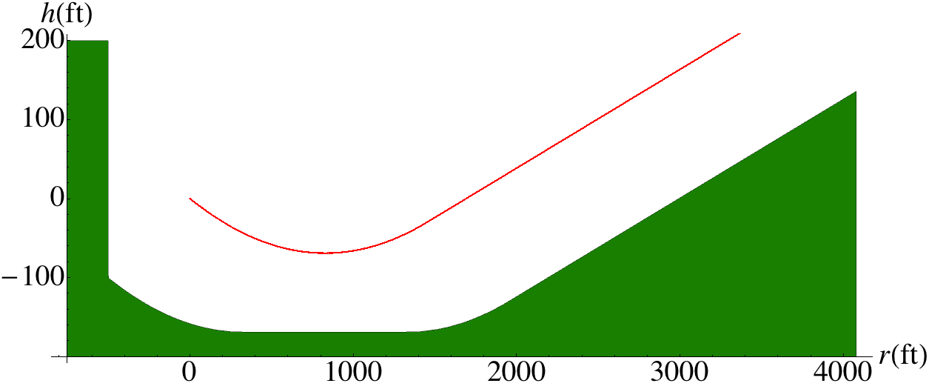


Inspiration
Towards a Formalization of the Active Corner Method for Collision Avoidance in PVS
Past work by Jeannin et al. verified collision avoidance safety for ACAS X
ACAS X is an airborne collision avoidance system that sends climb/descend commands to pilots to avoid mid-air collisions with approaching aircraft
Jeannin et al., TACAS ’15; Jeannin et al., STTT ‘17
Notes:
“This project was inspired by past work by Jeannin and others focused on verifying safety for ACAS X, a system that advises pilots on how to avoid mid-air collisions and near-misses with oncoming aircraft. Advisories take the form of vertical commands to climb, descend, or maintain altitude, which produce classes of planar trajectories.”

Slide 4
Inspiration
Towards a Formalization of the Active Corner Method for Collision Avoidance in PVS
Past work by Jeannin et al. verified collision avoidance safety for ACAS X
ACAS X is an airborne collision avoidance system that sends climb/descend commands to pilots to avoid mid-air collisions with approaching aircraft
How can we make sure a control system issues correct advisories?
Jeannin et al., TACAS ’15; Jeannin et al., STTT ‘17
Notes:
”Because of the safety-critical nature of ACAS X, there has been significant interest in verifying the correctness of its advisories; to ask “are the commands to climb or descend indeed correct, given a specific scenario?””

Slide 5
Outline
Towards a Formalization of the Active Corner Method for Collision Avoidance in PVS
FMCAD ’22
Collision avoidance problem statement
Introduction to active corner method
Original, geometric proof
FTSCS ’22
Proof certificate outline
Algebraic proof approach
PVS formalization

Slide 6

Inspiration
Towards a Formalization of the Active Corner Method for Collision Avoidance in PVS
Problem Statement
Inputs
A convex polygon
A known piecewise, planar trajectory
Goal
Automatically generate a symbolic, provably correct, quantifier-free safe region
Kheterpal et al., FMCAD ‘22; Jeannin et al., TACAS ’15; Jeannin et al., STTT ‘17
Notes:
To begin, let’s look at a general case of this collision avoidance task
Point out green is safe region

Slide 7
Inspiration
Towards a Formalization of the Active Corner Method for Collision Avoidance in PVS
Problem Statement
Inputs
A convex polygon
A known piecewise, planar trajectory
Goal
Automatically generate a symbolic, provably correct, quantifier-free safe region
Key insight: We must consider the trajectories of corners and more to construct a safe region
Jeannin et al., TACAS ’15; Jeannin et al., STTT ‘17

Slide 8
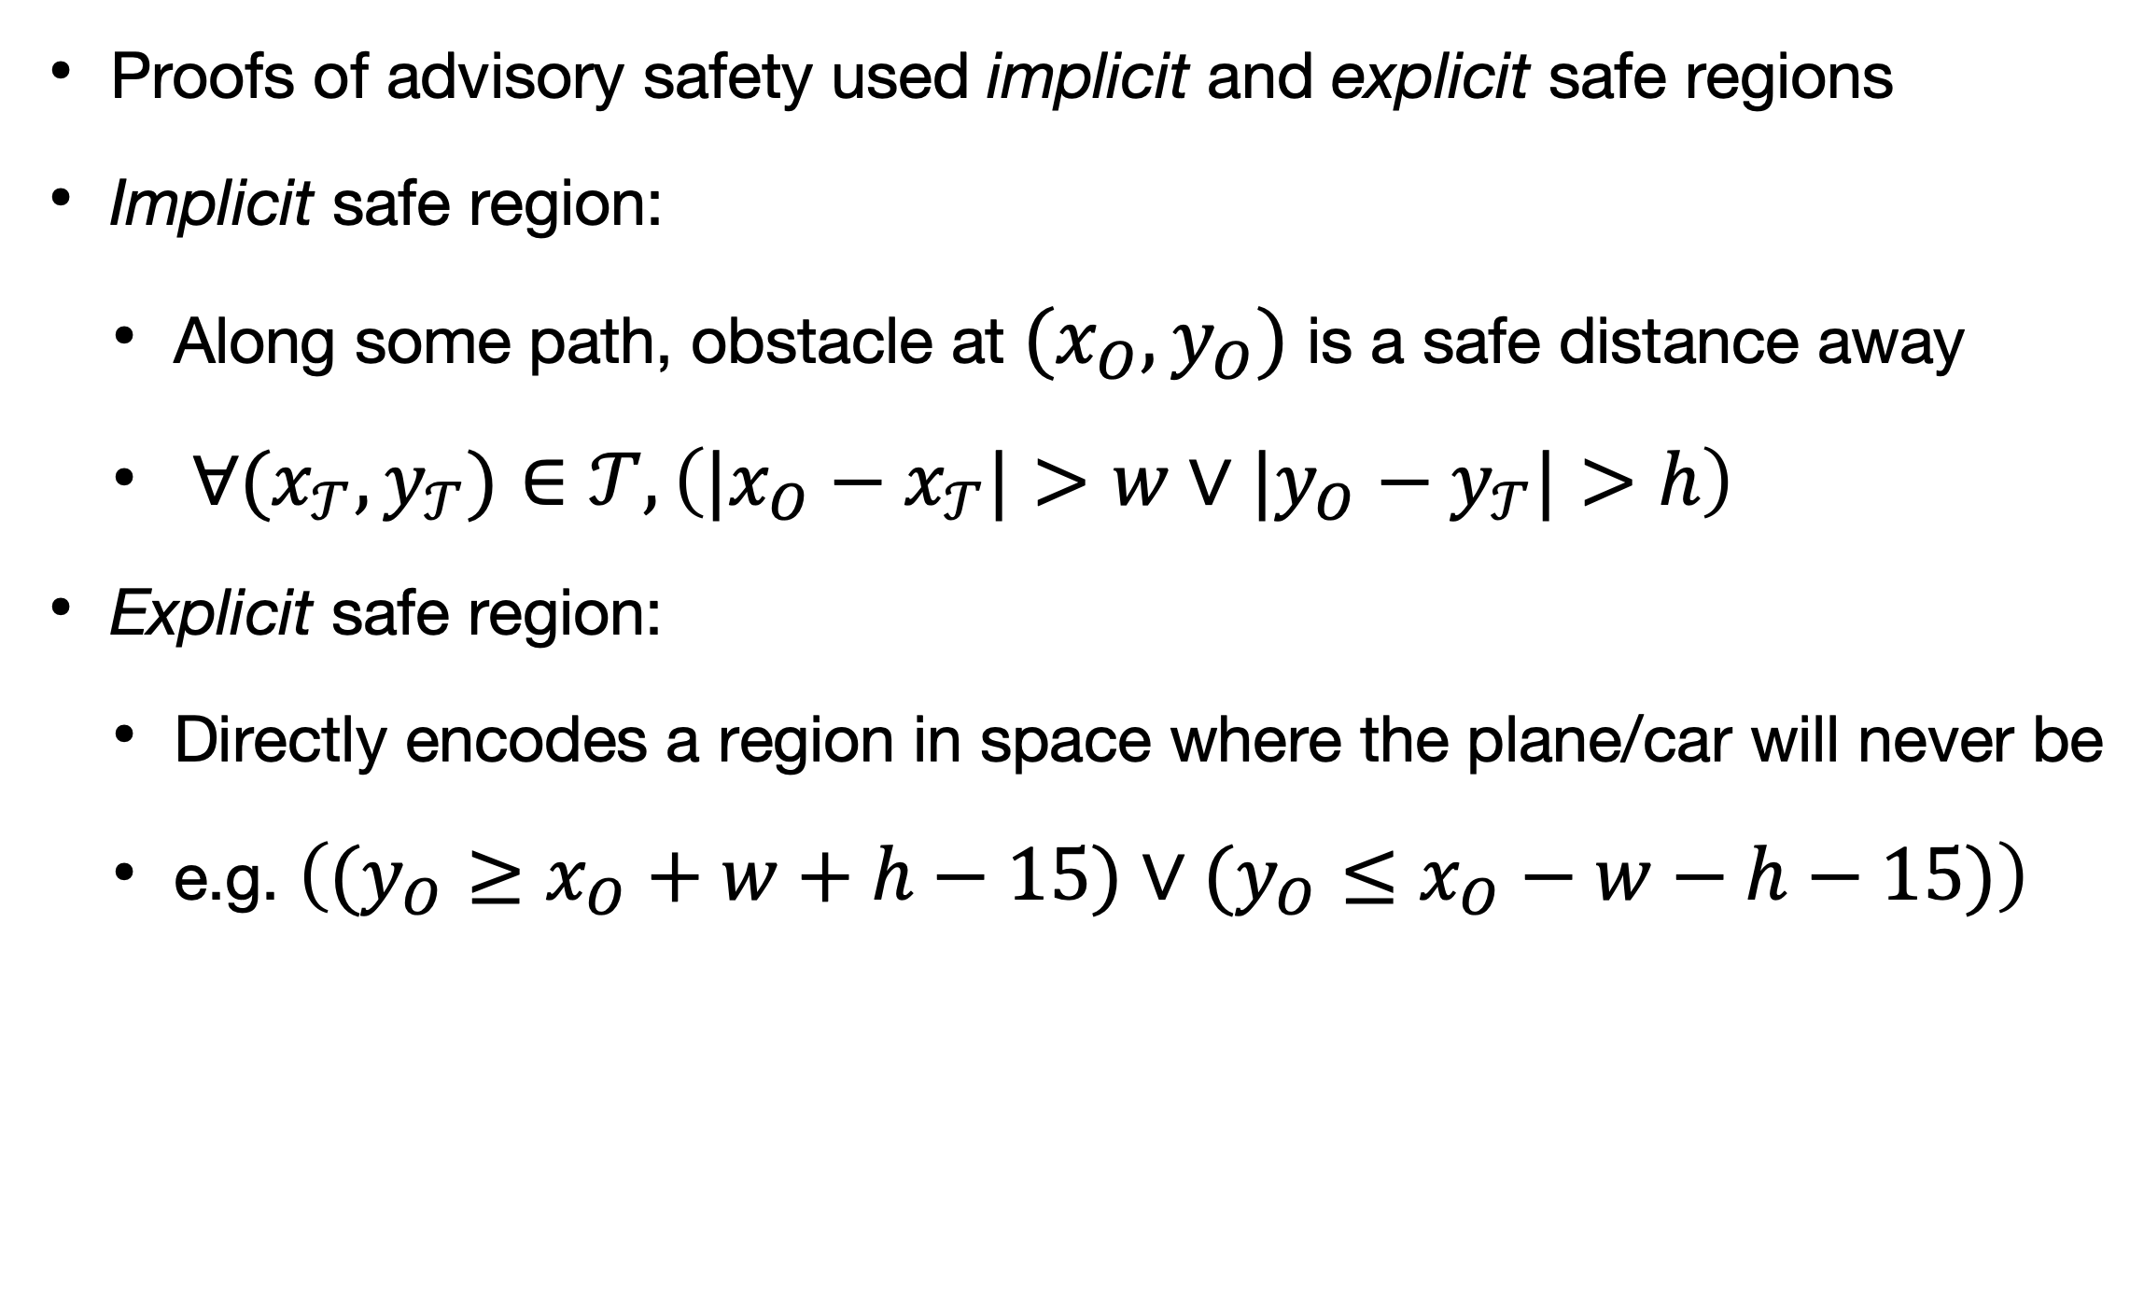
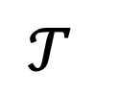
Inspiration
Towards a Formalization of the Active Corner Method for Collision Avoidance in PVS
Past Approach
Proofs of advisory safety used implicit and explicit safe regions
Implicit safe region:
Along some path, obstacle at $(x_{O},y_{O})$ is a safe distance away
$∀(x_{𝒯},y_{𝒯})∈𝒯,\left(|x_{O}−x_{𝒯}|>w∨|y_{O}−y_{𝒯}|>h\right)$
Explicit safe region:
Directly encodes a region in space where the plane/car will never be
e.g. $\left((y_{O}≥x_{O}+w+h−15)∨(y_{O}≤x_{O}−w−h−15)\right)$
$$𝒯$$
Adler et al., AIAA ’19; Abhishek et al., HSCC ‘20

Slide 9
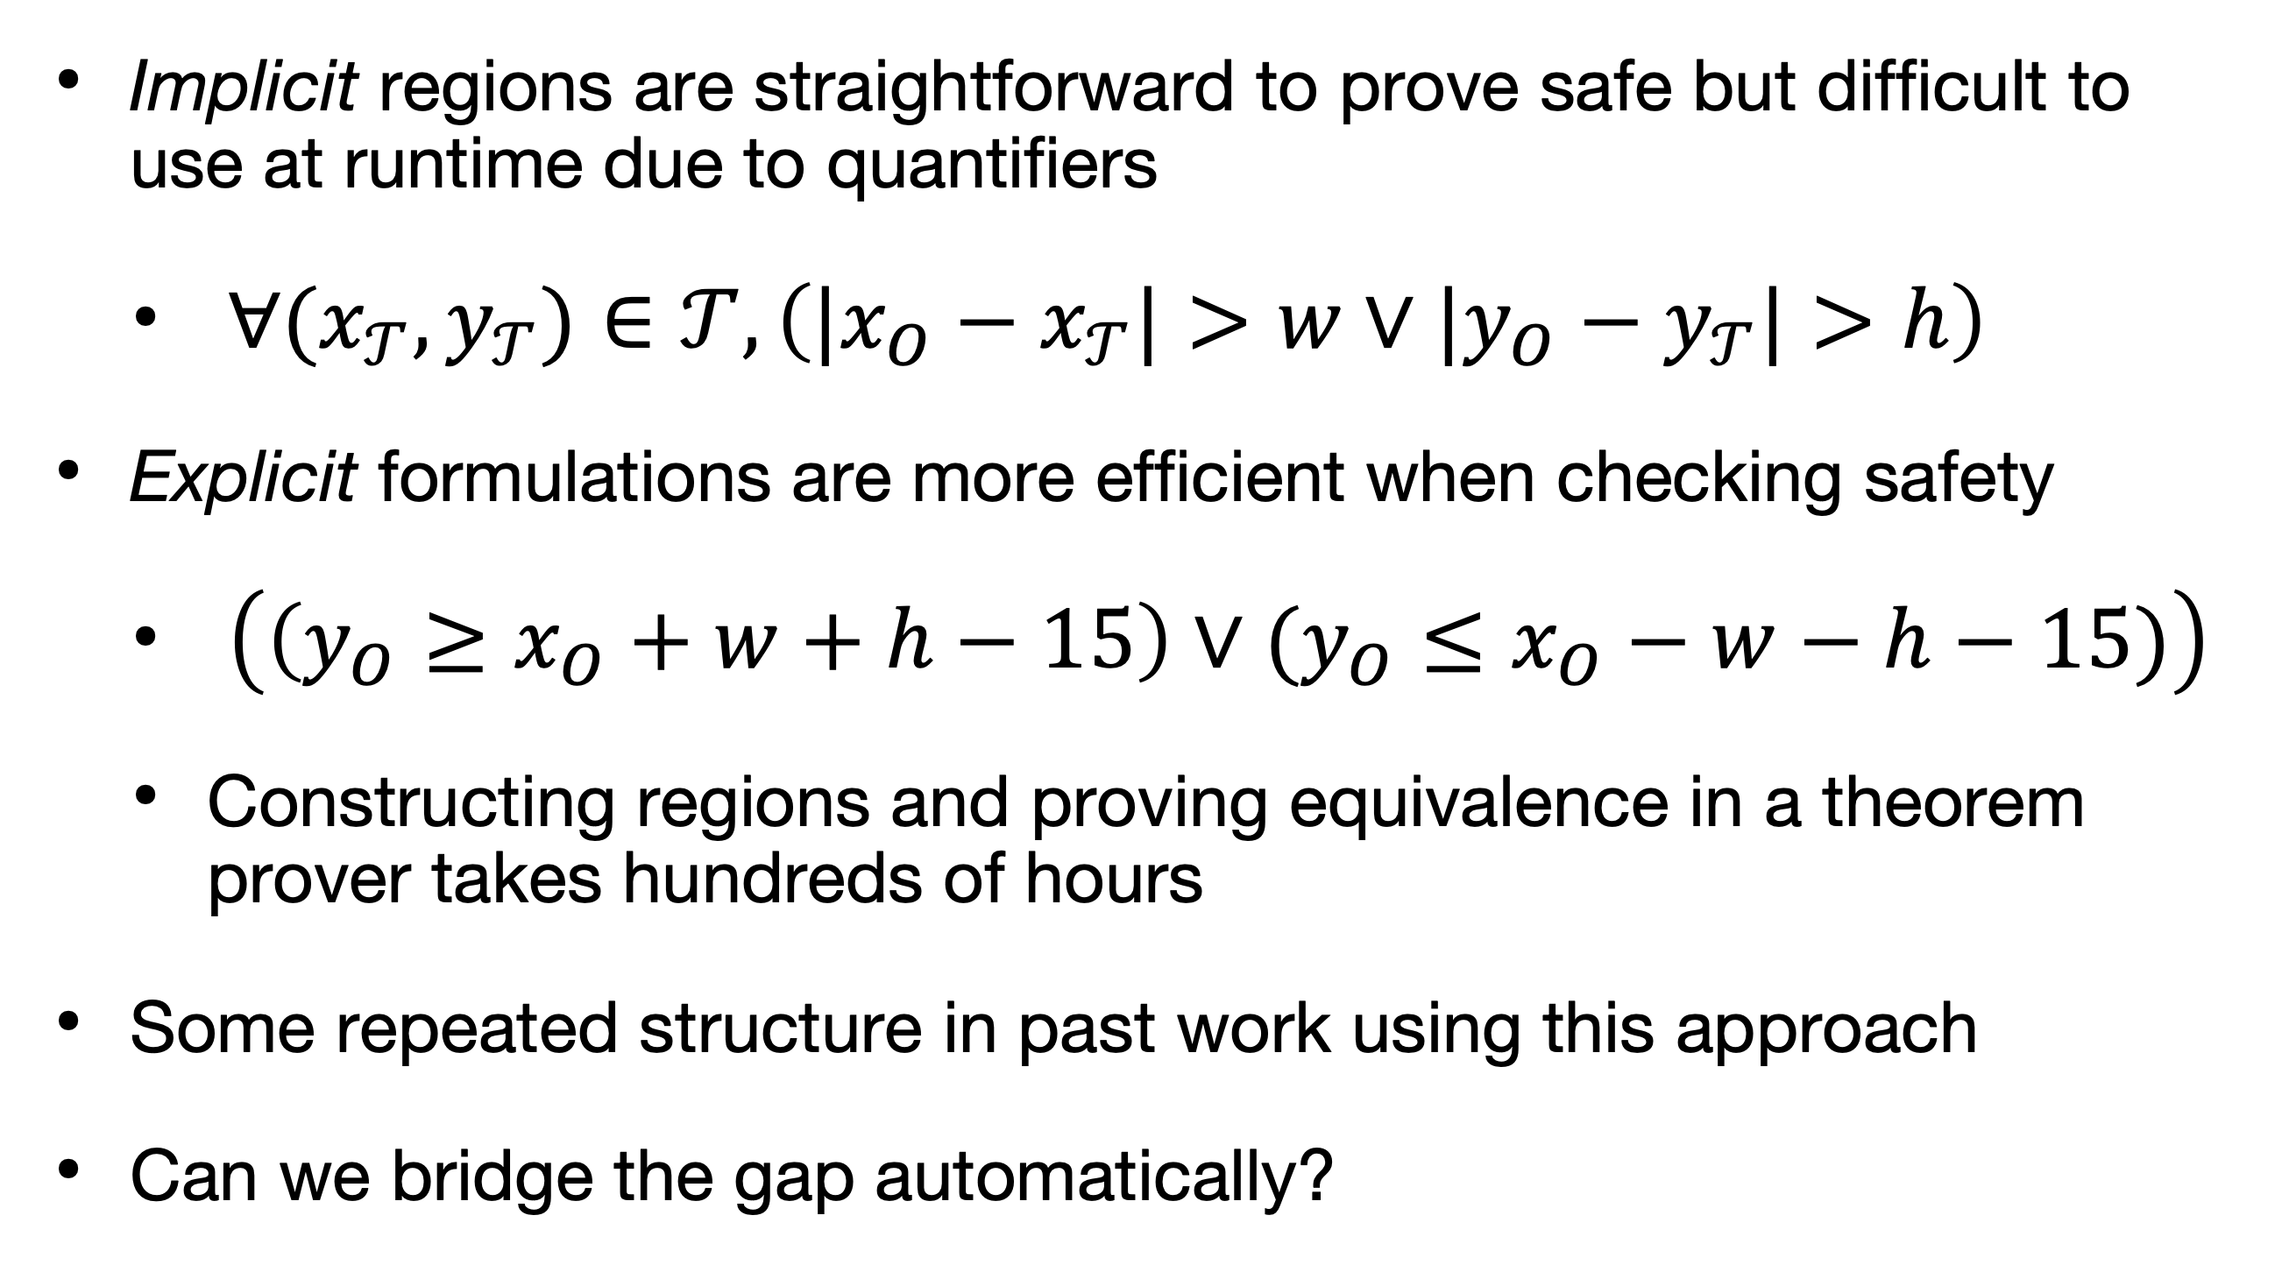
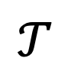
Inspiration
Towards a Formalization of the Active Corner Method for Collision Avoidance in PVS
Shortcomings
Implicit regions are straightforward to prove safe but difficult to use at runtime due to quantifiers
$∀(x_{𝒯},y_{𝒯})∈𝒯,\left(|x_{O}−x_{𝒯}|>w∨|y_{O}−y_{𝒯}|>h\right)$
Explicit formulations are more efficient when checking safety
$\left(\left(y_{O}≥x_{O}+w+h−15\right)∨(y_{O}≤x_{O}−w−h−15)\right)$
Constructing regions and proving equivalence in a theorem prover takes hundreds of hours
Some repeated structure in past work using this approach
Can we bridge the gap automatically?
$$𝒯$$
Adler et al., AIAA ’19; Abhishek et al., HSCC ‘20
Notes:
Implicit: if I give you an obstacle location (12, 50), it’s not obvious how to use that in the quantified form
Explicit: on the other hand, you can plug an obstacle location directly into an expression
- useful for runtime verification or testing, say, a decision table, as in the ACAS X case
”Some you may be thinking, why not use quantifier elimination? Quantifier elimination is indeed a natural candidate here, but as I'll detail later, the runtime is just too slow to rely on it, especially for symbolic applications"

Slide 10
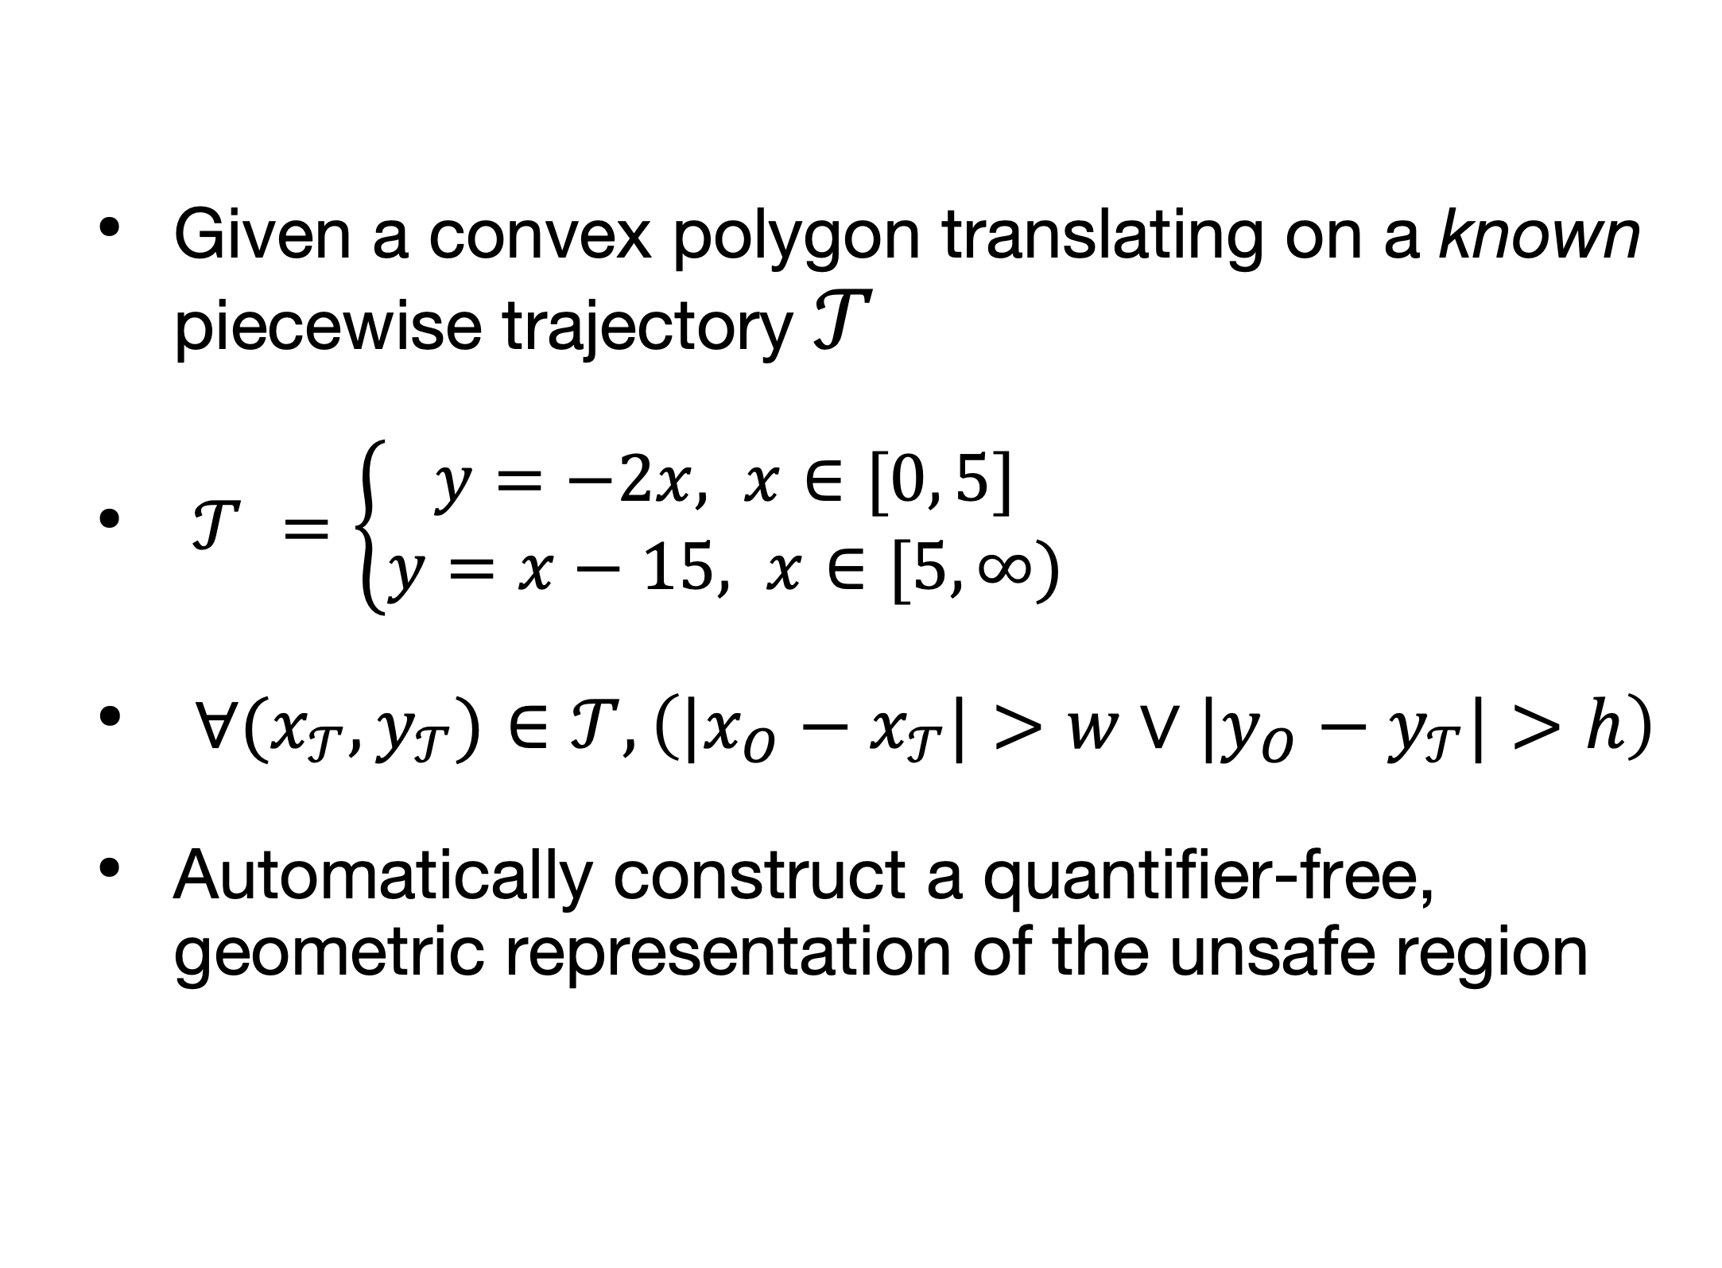
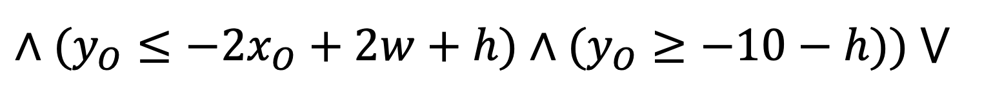
Algorithm
Towards a Formalization of the Active Corner Method for Collision Avoidance in PVS
Overview
Given a convex polygon translating on a known piecewise trajectory $𝒯$
$𝒯 =\left\{\begin{aligned}y=−2x, x∈[0, 5] \\ &y=x−15, x∈[5, ∞)\end{aligned}\right.$
$∀(x_{𝒯},y_{𝒯})∈𝒯,\left(|x_{O}−x_{𝒯}|>w∨|y_{O}−y_{𝒯}|>h\right)$
Automatically construct a quantifier-free, geometric representation of the unsafe region
$$((x_{O}≥−w)∧(y_{O}≤h)∧(y_{O}≥−2x_{O}−2w−h)∧(x_{O}≤5+w)$$
$$∧(y_{O}≤−2x_{O}+2w+h)∧(y_{O}≥−10−h)) ⋁$$
$$((x_{O}≥5−w)∧(y_{O}≥−10−h)∧(y_{O}≤x_{O}+w+h−15)∧(y_{O}≥x_{O}−w−h−15))$$
Notes:
TODO fix curly bracket math appearance

Slide 11
Algorithm
Towards a Formalization of the Active Corner Method for Collision Avoidance in PVS
Intuition: Active Corners
“Follow the corners”
We found that the safe region boundaries were either sides of the polygon or trajectories of its corners

Slide 12
Algorithm
Towards a Formalization of the Active Corner Method for Collision Avoidance in PVS
Intuition: Choosing active corners
“Follow the corners”
We found that the safe region boundaries were either sides of the polygon or trajectories of its corners
Choose which active corners to follow based on the angle of the trajectory
Notes:
“outermost extent of the polygon as it moves along the centerline trajectory”
“I’ve shown symmetric polygons here but this process of identifying active corners generalizes to any convex polygon”
this is why it’s important to only consider convex polygons, because non-convex polygons don’t have uniquely identifying exterior angles

Slide 13
Algorithm
Towards a Formalization of the Active Corner Method for Collision Avoidance in PVS
Intuition
“Follow the corners”
We found that the safe region boundaries were either sides of the polygon or trajectories of its corners
Choose which active corners to follow based on the angle of the trajectory
At transition points, the active corner changes: must also include polygon in the region
Using only corners misses the notch (red)
Notes:
“Boundaries of the safe region, or more formally, the area swept out by the polygon as it moves along the trajectory”
“what we call the notch”

Slide 14
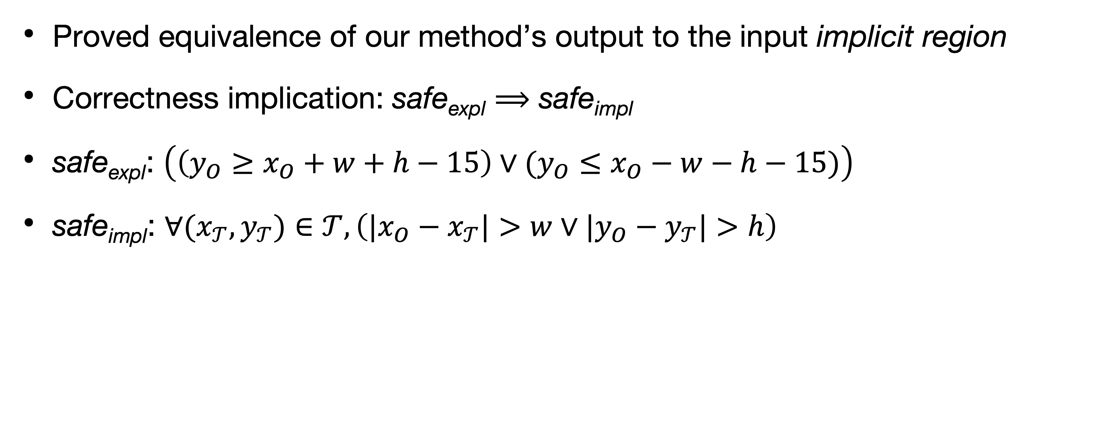
Proof Structure
Towards a Formalization of the Active Corner Method for Collision Avoidance in PVS
Proved equivalence of our method’s output to the input implicit region
Correctness implication: safe_{expl} $⟹$ safe_{impl}
safe_{expl}: $\left(\left(y_{O}≥x_{O}+w+h−15\right)∨(y_{O}≤x_{O}−w−h−15)\right)$
safe_{impl}: $∀(x_{𝒯},y_{𝒯})∈𝒯,\left(|x_{O}−x_{𝒯}|>w∨|y_{O}−y_{𝒯}|>h\right)$
Notes:
Our method views this safe region computation problem as following corners with occasional polygons
but proof ensures our approach is correct but focusing directly on the transition points
- left and right endpoints are both transition points, two points at which we account for the notch by using the polygon itself
proof strategy considers this almost inside-out: focus on transition points & polygons there, and follow the corners in the between

Slide 15

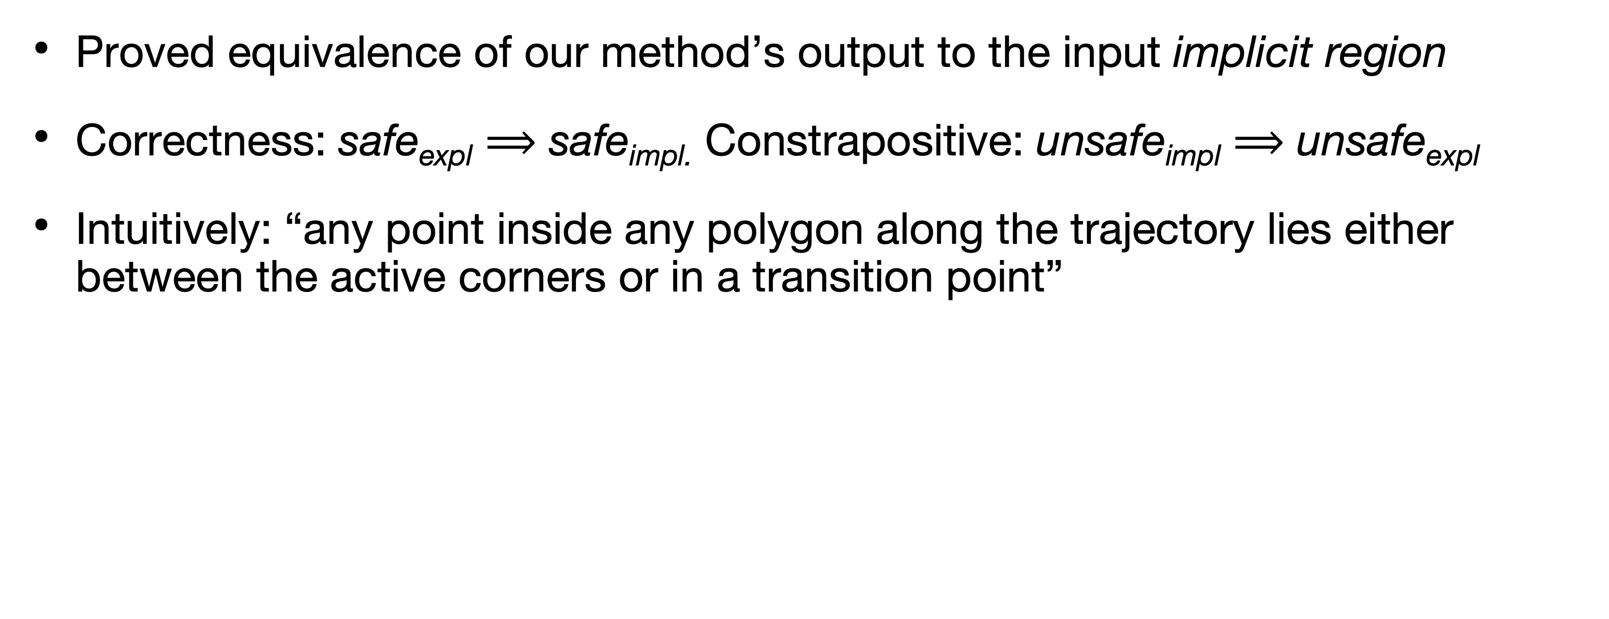
Proof Structure
Towards a Formalization of the Active Corner Method for Collision Avoidance in PVS
Proved equivalence of our method’s output to the input implicit region
Correctness: safe_{expl} $⟹$ safe_{impl.} Constrapositive: unsafe_{impl} $⟹$ unsafe_{expl}
Intuitively: “any point inside any polygon along the trajectory lies either between the active corners or in a transition point”
Notes:
Our method views this safe region computation problem as following corners with occasional polygons
but proof ensures our approach is correct but focusing directly on the transition points
- left and right endpoints are both transition points, two points at which we account for the notch by using the polygon itself
proof strategy considers this almost inside-out: focus on transition points & polygons there, and follow the corners in the between

Slide 16
Proof Structure
Towards a Formalization of the Active Corner Method for Collision Avoidance in PVS
Original Approach
Proved equivalence of our method’s output to the input implicit region
Proof deals with (rotated) segments of trajectory over which there is no active corner change and includes start & end transition points
Accounts for notch handling this way
Notes:
“Our proof goes piece-by-piece, looking at segments of the trajectory where the active corner does not change. This requires mild assumptions that we can separate the trajectory into a finite number of segments over a finite domain; I can discuss these more at the end.”
Our method views this safe region computation problem as following corners with occasional polygons
but proof ensures our approach is correct but focusing directly on the transition points
- left and right endpoints are both transition points, two points at which we account for the notch by using the polygon itself
proof strategy considers this almost inside-out: focus on transition points & polygons there, and follow the corners in the between

Slide 17
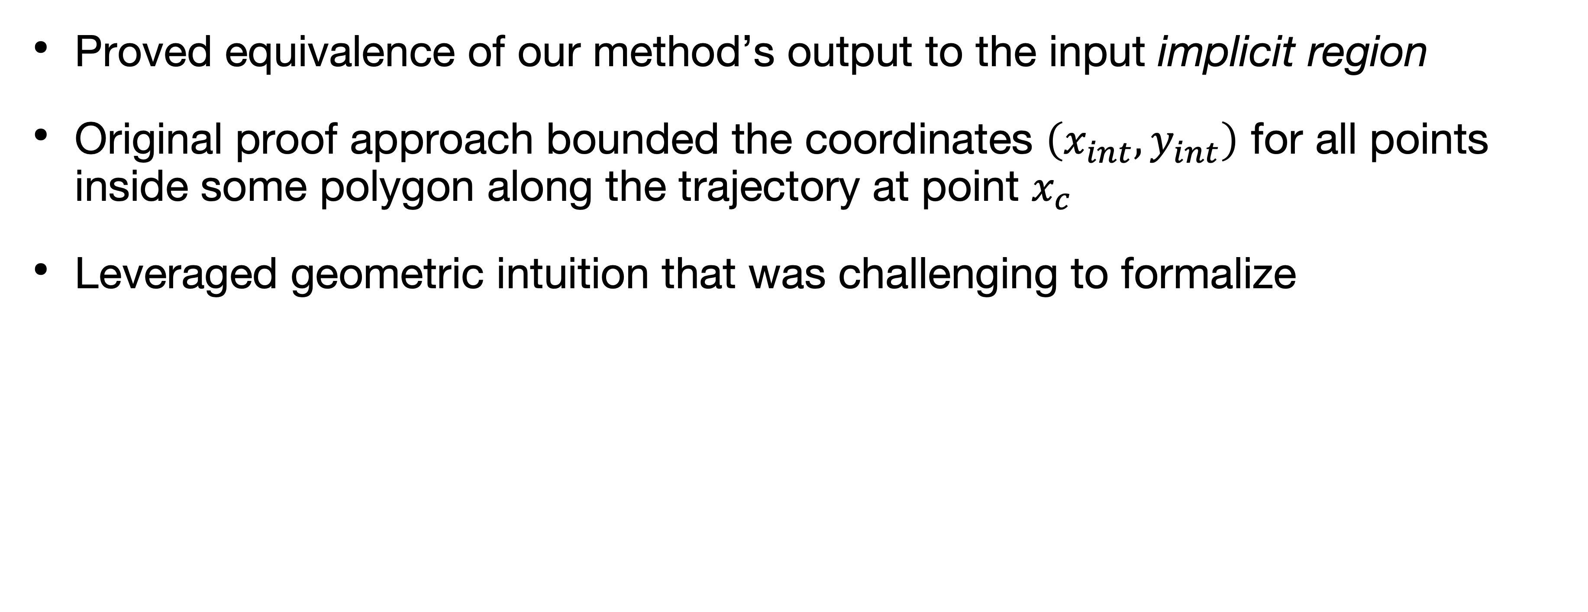
Proof Structure
Towards a Formalization of the Active Corner Method for Collision Avoidance in PVS
Original Approach
Proved equivalence of our method’s output to the input implicit region
Original proof approach bounded the coordinates $\left(x_{int}, y_{int}\right)$ for all points inside some polygon along the trajectory at point $x_{c}$
Leveraged geometric intuition that was challenging to formalize

Slide 18
How do you formalize a geometric proof?
Notes:
But we have a problem: how do you formalize a geometric proof? When you talk to people, you can convince them of geometry by saying things like “look at the picture”. Computer vision is good, but not good enough that you can convince a theorem prover by using “proof by picture”.

Slide 19
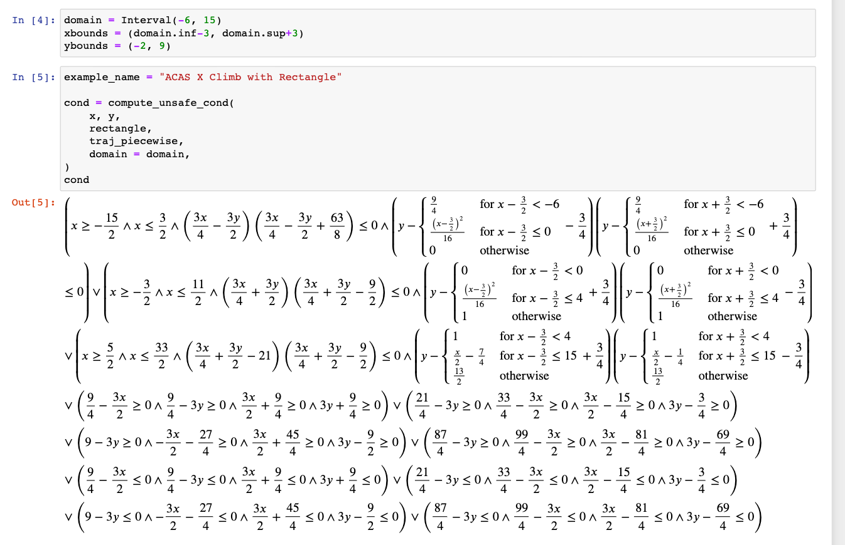
Proof Approach
Towards a Formalization of the Active Corner Method for Collision Avoidance in PVS
Why Certificates?
Two potential formalizations
Formally prove algorithm correctness
Formally show result correctness: certificates
Certificates pair well with our automated implementation of the active corner method
Users can verify correctness of results

Slide 20
Proof Approach
Towards a Formalization of the Active Corner Method for Collision Avoidance in PVS
The PVS Theorem Prover
Proofs formalized in the Prototype Verification System (PVS)
PVS consists of:
Specification language for expressing formal models
Automated interactive theorem prover to verify model correctness
Developed by SRI with support from NASA Langley Formal Methods

Slide 21
Proof Approach
Towards a Formalization of the Active Corner Method for Collision Avoidance in PVS
Algebraic Approach
Novel approach in this paper is more easily represented and proved in PVS
Represent polygon as intersecting inequalities and manipulate to yield explicit formulation
Target different subclauses from explicit formulation based on which corners are active
Proof currently handles linear trajectories

Slide 22
Proof Approach
Towards a Formalization of the Active Corner Method for Collision Avoidance in PVS
Algebraic Approach
Novel approach in this paper is more easily represented and proved in PVS
Represent polygon as intersecting inequalities and manipulate to yield explicit formulation
Target different subclauses from explicit formulation based on which corners are active
Proof currently handles linear trajectories

Slide 23
Proof Approach
Towards a Formalization of the Active Corner Method for Collision Avoidance in PVS
Algebraic Approach
Novel approach in this paper is more easily represented and proved in PVS
Represent polygon as intersecting inequalities and manipulate to yield explicit formulation
Target different subclauses from explicit formulation based on which corners are active
Proof currently handles linear trajectories

Slide 24
Proof Approach
Towards a Formalization of the Active Corner Method for Collision Avoidance in PVS
Algebraic Approach
Novel approach in this paper is more easily represented and proved in PVS
Represent polygon as intersecting inequalities and manipulate to yield explicit formulation
Target different subclauses from explicit formulation based on which corners are active
Proof currently handles linear trajectories

Slide 25
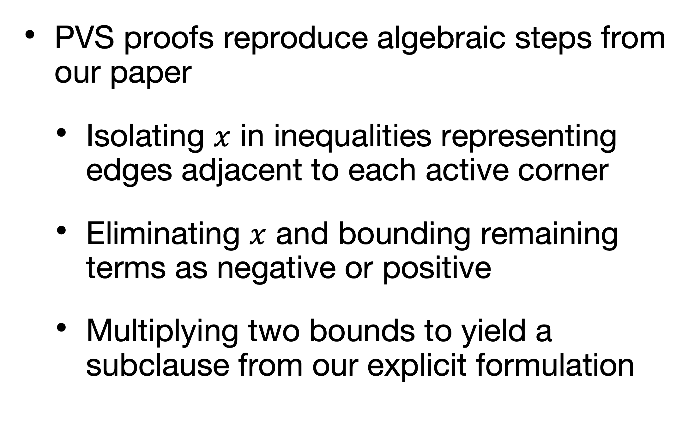
PVS Proofs
Towards a Formalization of the Active Corner Method for Collision Avoidance in PVS
PVS proofs reproduce algebraic steps from our paper
Isolating $x$ in inequalities representing edges adjacent to each active corner
Eliminating $x$ and bounding remaining terms as negative or positive
Multiplying two bounds to yield a subclause from our explicit formulation
SquareSound(xo, yo, alpha: real) : bool =
(EXISTS (x : real) :
((xo - x) <= 1 AND (xo - x) >= -1 AND
(yo - alpha*x) <= 1 AND (yo - alpha*x) >= -1))
IMPLIES
((yo - alpha*xo - alpha - 1) *
(yo - alpha*xo + alpha + 1) <= 0) OR
((yo - alpha*xo - alpha + 1) *
(yo - alpha*xo + alpha - 1) <= 0)

Slide 26
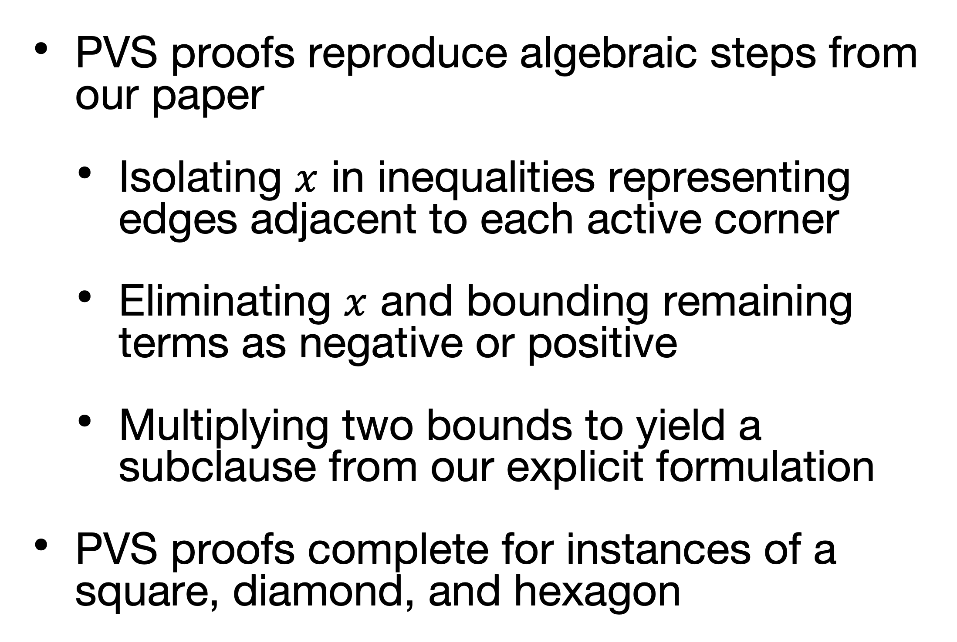
PVS Proofs
Towards a Formalization of the Active Corner Method for Collision Avoidance in PVS
PVS proofs reproduce algebraic steps from our paper
Isolating $x$ in inequalities representing edges adjacent to each active corner
Eliminating $x$ and bounding remaining terms as negative or positive
Multiplying two bounds to yield a subclause from our explicit formulation
PVS proofs complete for instances of a square, diamond, and hexagon
DiamondSound(xo, yo, alpha : real) : bool =
(EXISTS(x : real) :
((yo - alpha*x <= xo - x + 1) AND
(yo - alpha*x >= xo - x - 1) AND
(yo - alpha*x <= -xo + x + 1) AND
(yo - alpha*x >= -xo + x - 1)))
IMPLIES
((yo - alpha*xo + alpha) *
(yo - alpha*xo - alpha) <= 0 OR
(yo - alpha*xo + 1) *
(yo - alpha*xo - 1) <= 0)

Slide 27
Summary
Towards a Formalization of the Active Corner Method for Collision Avoidance in PVS
Automated method for constructing symbolic geometric safe regions without quantifiers from convex polygon and piecewise trajectories
Proof of correctness for the active corner method
Original approach leveraging bounds on trajectory derivative from polygon
Novel, in-progress approach representing polygon using inequalities
PVS lemmas proven for specific instances of this problem

Slide 28
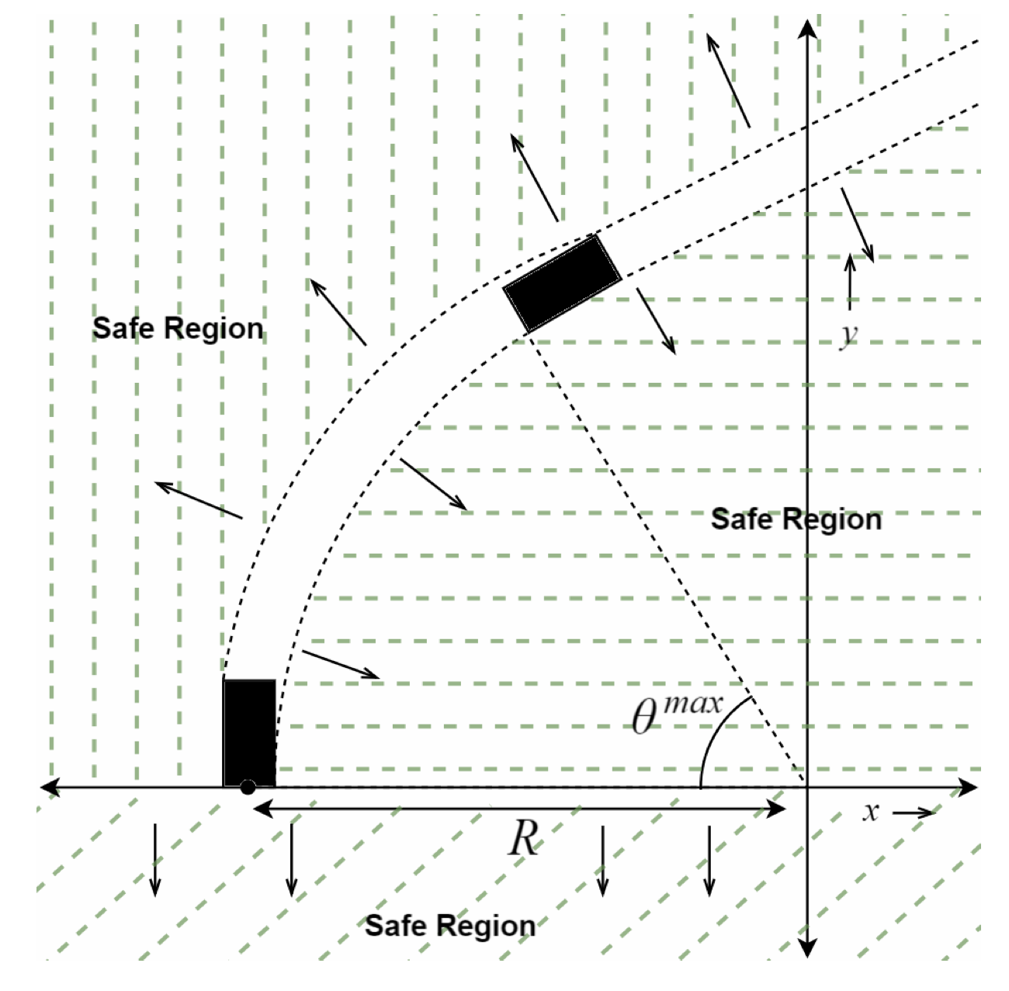
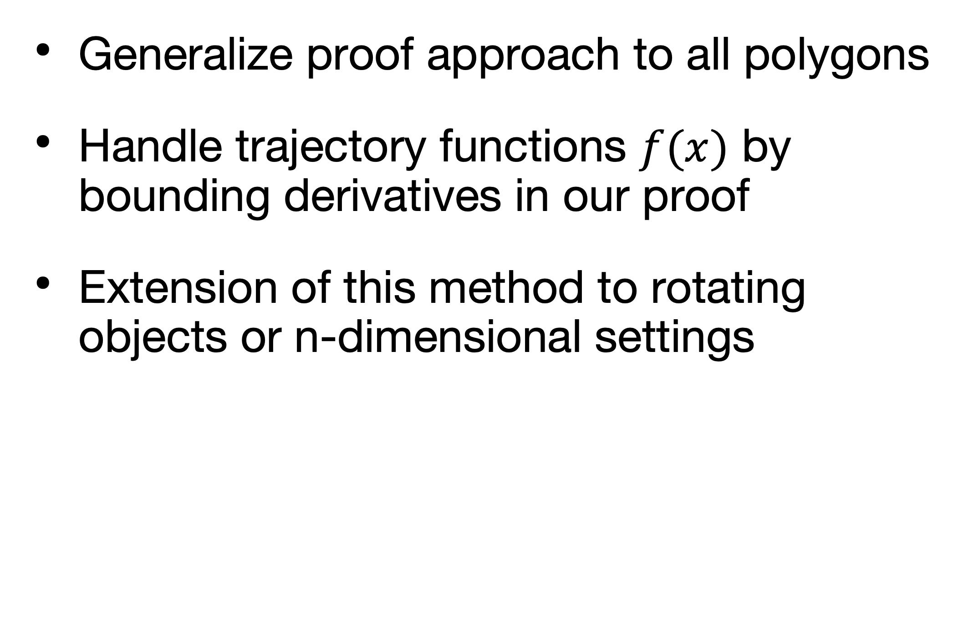
Future Work
Towards a Formalization of the Active Corner Method for Collision Avoidance in PVS
Generalize proof approach to all polygons
Handle trajectory functions $f(x)$ by bounding derivatives in our proof
Extension of this method to rotating objects or n-dimensional settings
Kheterpal et al., FTSCS @ SPLASH ‘22

Slide 29

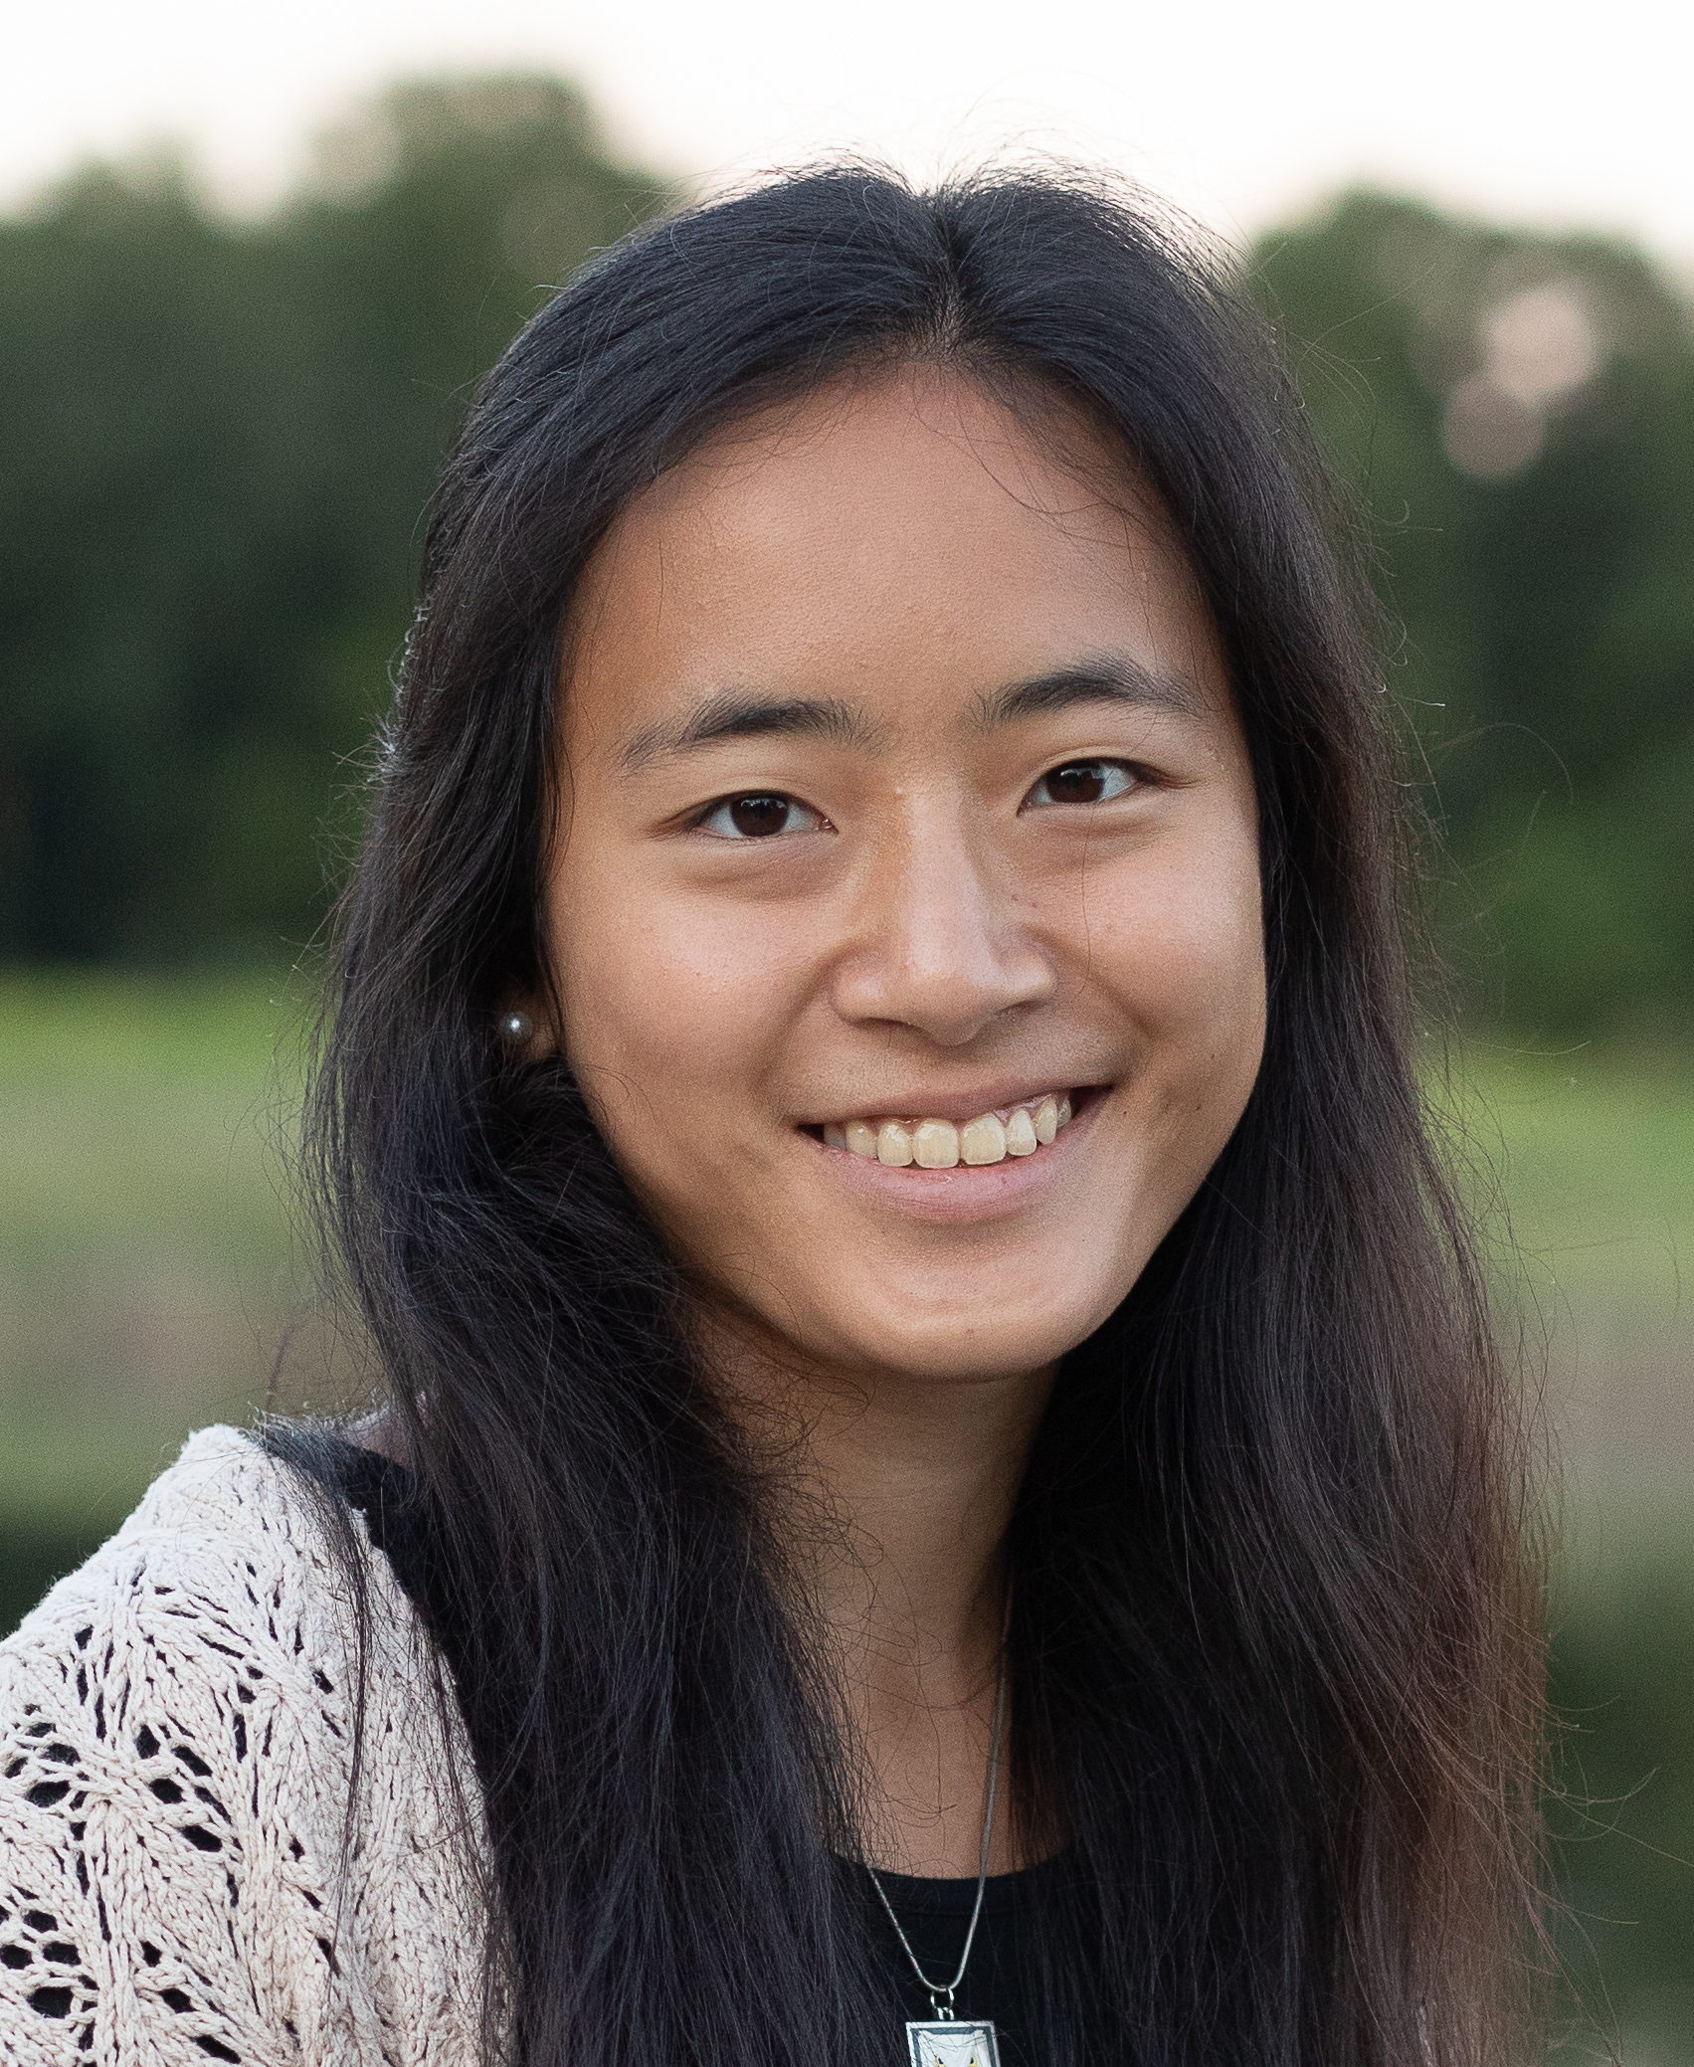


Thanks!
Towards a Formalization of the Active Corner Method for Collision Avoidance in PVS
Any questions?

Slide 30
Thanks!
Towards a Formalization of the Active Corner Method for Collision Avoidance in PVS
Any questions?
Backup slides next

Slide 31

Backup

Slide 32
Proof Structure
Automating Geometric Proofs of Collision Avoidance with Active Corners
(Mild) Assumptions
Proof considers trajectories with a finite number of transition points over a a finite domain
Without this, there are an infinite number of notches to account for even on finite domains
In practice, this assumption is mild, though pathological trajectories do exist
sin(1/x)

Slide 33
Performance Evaluation
Automating Geometric Proofs of Collision Avoidance with Active Corners
Dubins Path
Log scale
Fully symbolic Dubins path: semicircular segments connected by straight lines
CAD RAM usage grows to several GB as it fails to terminate
Active corner method memory usage stays under 100 MB if terminating

Slide 34
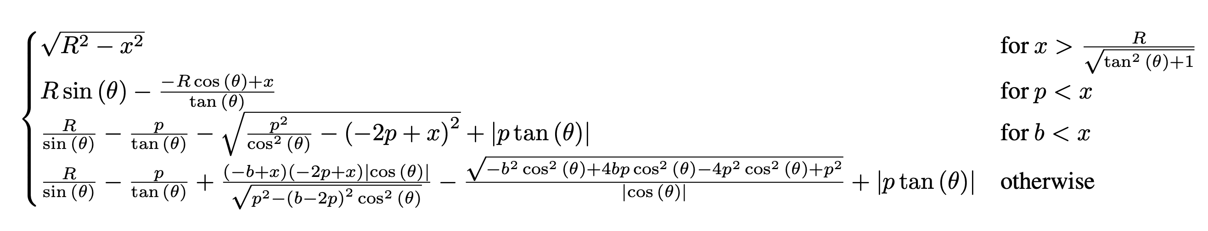
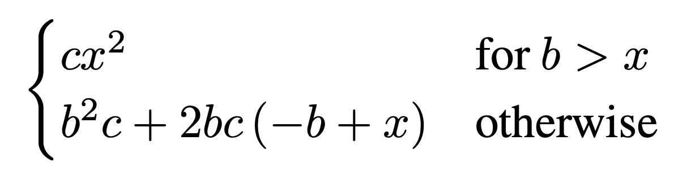
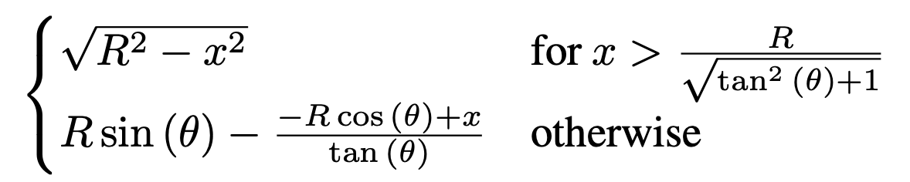
Performance Evaluation
ACAS X
UAV
Dubins

Slide 35
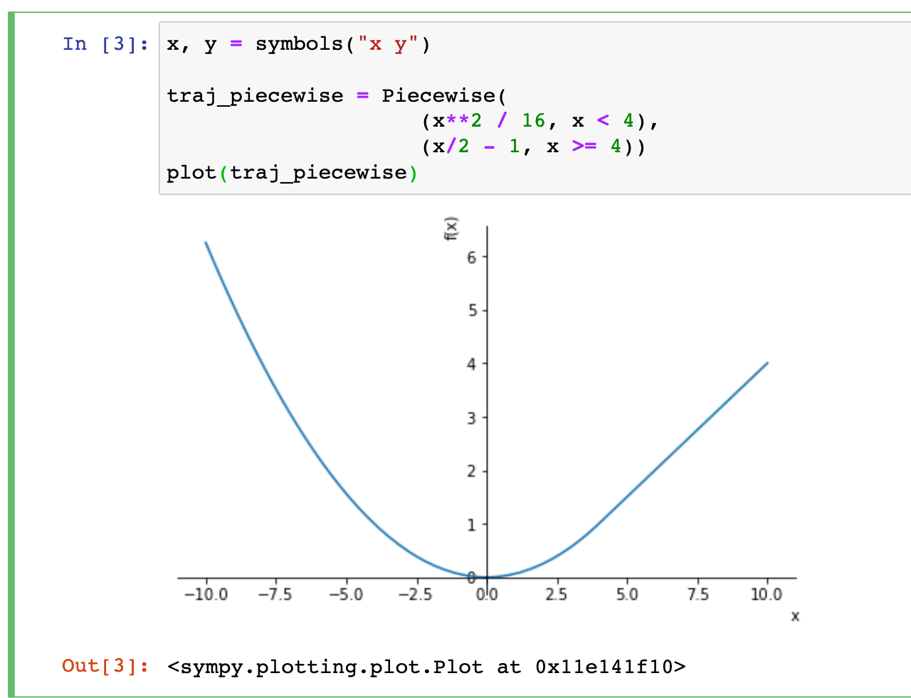
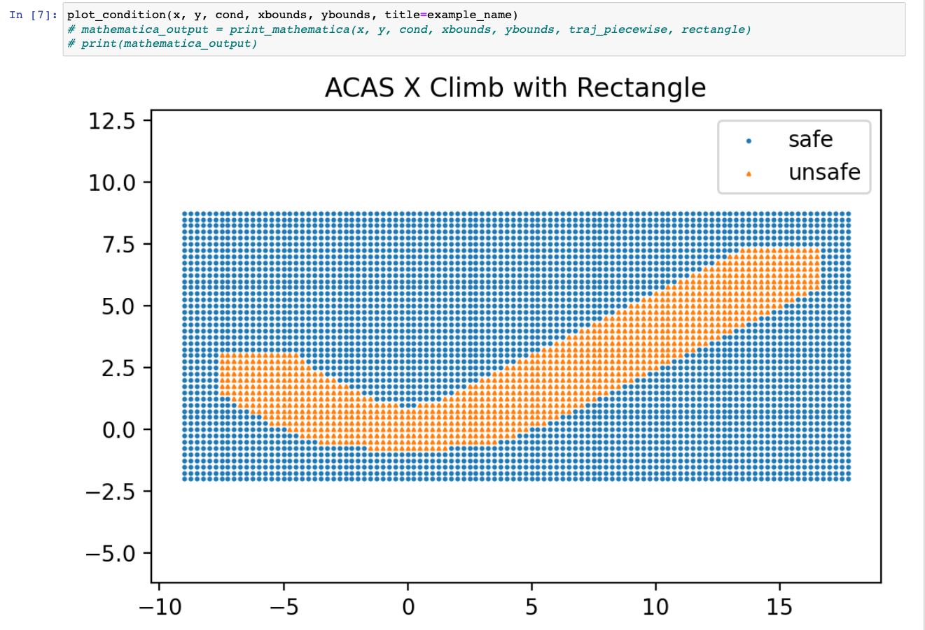
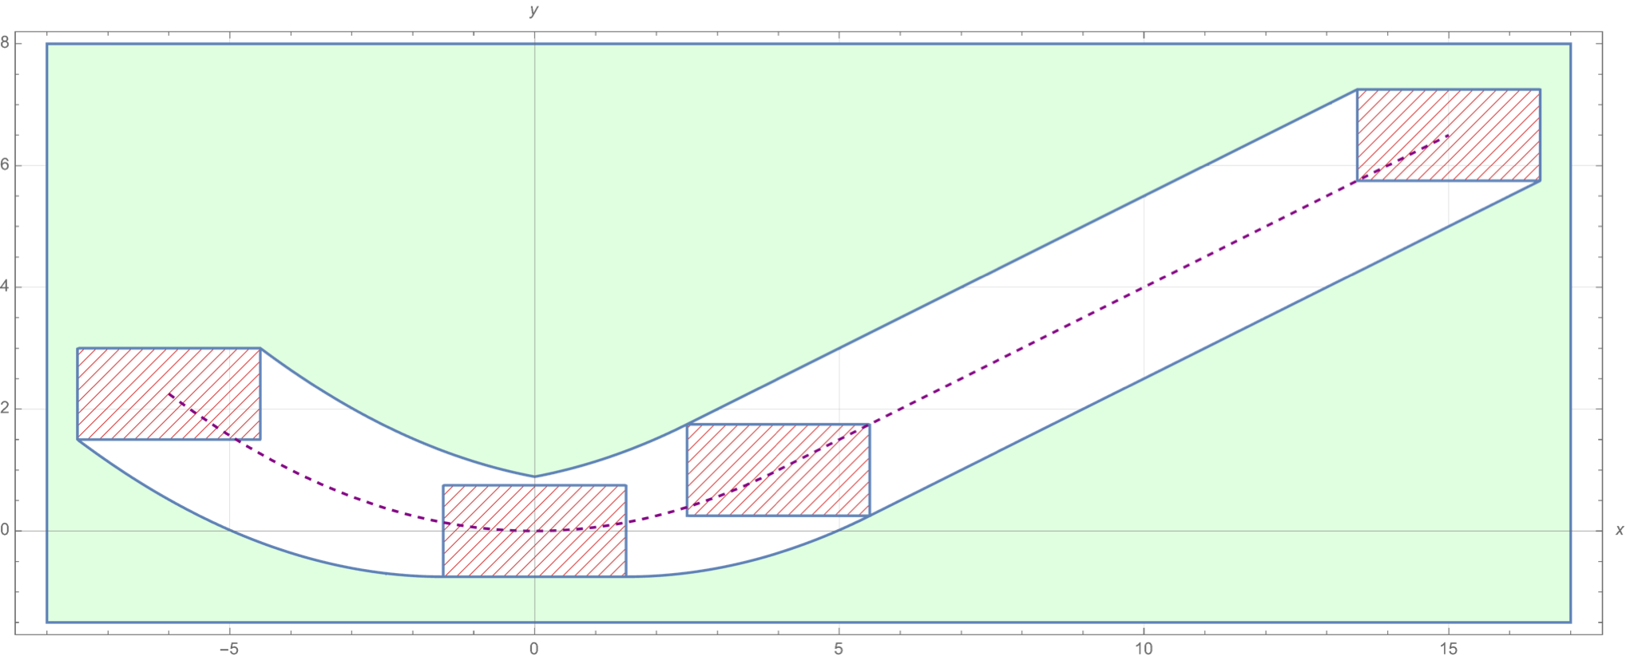

Implementation
Automating Geometric Proofs of Collision Avoidance with Active Corners
We have built an open-source library implementing the active corner method
Uses Python and Sympy for symbolic math
Automatically generates fully symbolic safe or unsafe regions
Available on Github

Slide 36
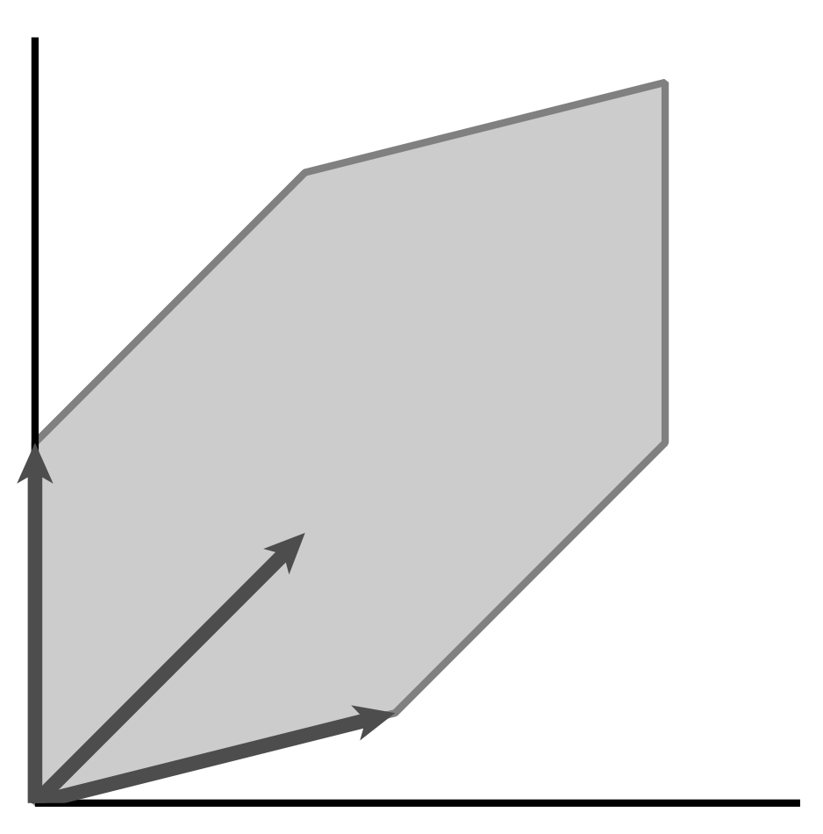
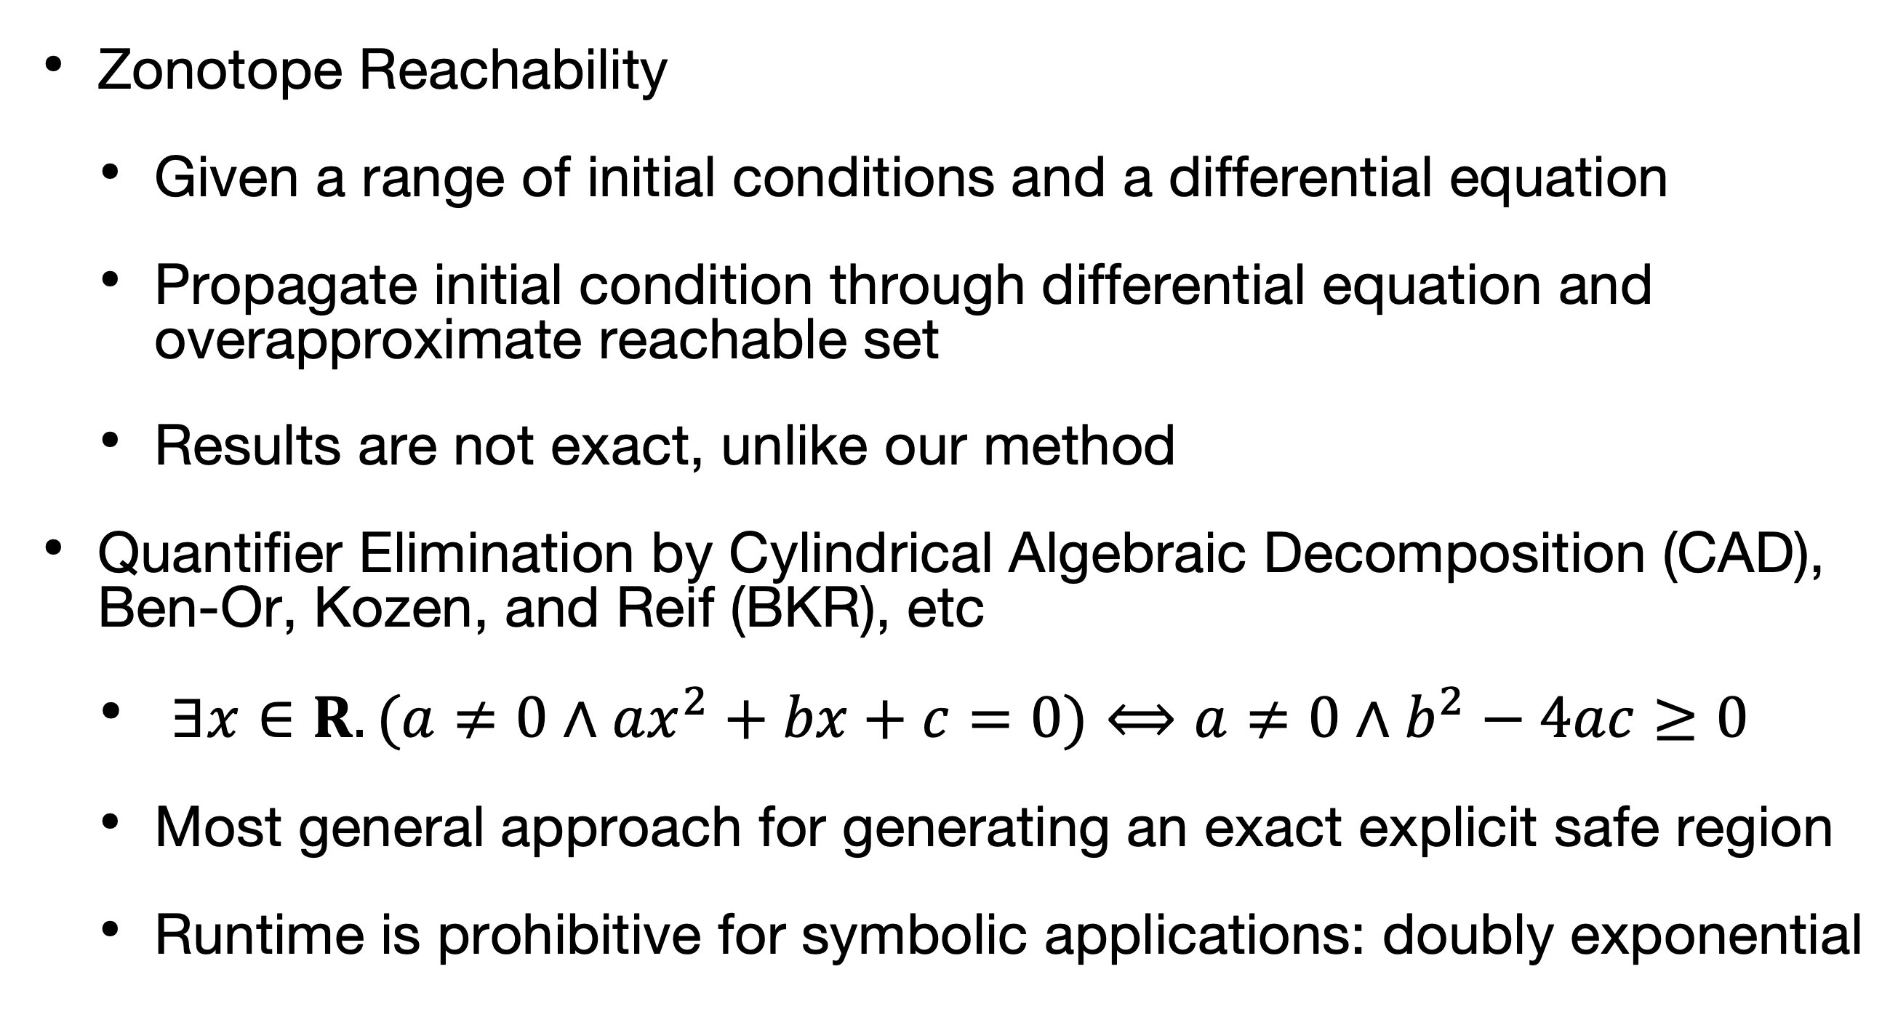
Related Work
Automating Geometric Proofs of Collision Avoidance with Active Corners
Reachability & Safety
Zonotope Reachability
Given a range of initial conditions and a differential equation
Propagate initial condition through differential equation and overapproximate reachable set
Results are not exact, unlike our method
Quantifier Elimination by Cylindrical Algebraic Decomposition (CAD), Ben-Or, Kozen, and Reif (BKR), etc
$∃x∈R.(a≠0∧ax^{2}+bx+c=0)⟺a≠0∧b^{2}−4ac≥0$
Most general approach for generating an exact explicit safe region
Runtime is prohibitive for symbolic applications: doubly exponential
Collins, ATFL 1975. Ben-Or, Kozen, and Reif, JCSS 1986.
Notes:
The runtime is doubly exponential in the total number of symbolic variables (not just the ones we quantify over), which means CAD is not just slow online – it may never terminate even in offline settings.
QE:
originally applied to reals by Tarski’s theorem showing that QE over reals is possible and that real arithmetic is decidable
algorithm is CAD (cylindrical algebraic decomposition)

Slide 37
Applications
Automating Geometric Proofs of Collision Avoidance with Active Corners
Applied to two past papers from our group performing collision avoidance verification
TACAS ’15 ACAS X paper verifying aircraft collision avoidance advisories
Rectangular object
Parabolic-then-linear path
Jeannin et al., TACAS ‘15

Slide 38
Performance Evaluation
Automating Geometric Proofs of Collision Avoidance with Active Corners
Case Study 1
TACAS ’15 ACAS X verification paper with side-view of aircraft collision avoidance advisories
For this polynomial example, CAD performs comparably to our implementation for numeric cases
Our implementation begins to beat CAD as the problem becomes increasingly symbolic

Slide 39
Performance Evaluation
Automating Geometric Proofs of Collision Avoidance with Active Corners
Case Study 1
TACAS ’15 ACAS X verification paper with side-view of aircraft collision avoidance advisories
As for memory usage, CAD uses less memory than our implementation
Note that Mathematica is purpose-built for efficient mathematical computation

Slide 40
Applications
Automating Geometric Proofs of Collision Avoidance with Active Corners
Case Study 2
UAV top-down collision avoidance
Approximate circle as a hexagon
Circular-then-linear path
Adler et al., AIAA ’19.

Slide 41
Performance Evaluation
Automating Geometric Proofs of Collision Avoidance with Active Corners
Case Study 2
Log scale
UAV top-down collision avoidance
CAD does not terminate for all but the fully numeric example
Ran overnight on an iMac Pro with 128GB RAM
Our implementation runs in under a minute at worst

Slide 42
Performance Evaluation
Automating Geometric Proofs of Collision Avoidance with Active Corners
Case Study 2
Log scale
UAV top-down collision avoidance
For all but the fully numeric case, CAD memory usage explodes to over 50 GB
Our implementation keeps memory usage under 25 MB

Slide 43
Performance Evaluation
Automating Geometric Proofs of Collision Avoidance with Active Corners
Dubins Path
Tested the active corner method with a highly non-polynomial trajectory
Fully symbolic Dubins path: semicircular segments connected by straight lines
Commonly used for robot motion planning

Slide 44
Performance Evaluation
Automating Geometric Proofs of Collision Avoidance with Active Corners
Dubins Path
Log scale
Fully symbolic Dubins path: semicircular segments connected by straight lines
CAD does not terminate for any case, including numeric examples
Active corner method fails to terminate for a symbolic hexagon
Too many transition points
Ran overnight on an iMac Pro with 128GB RAM

Slide 45
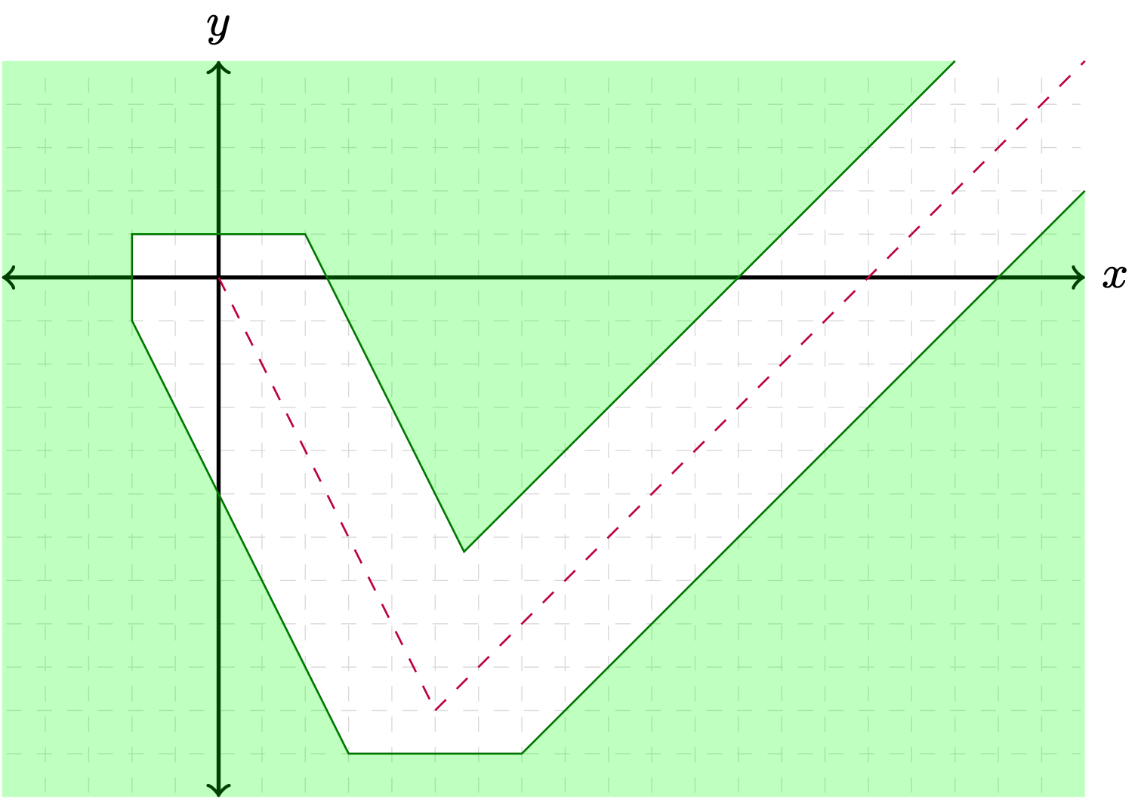
Inspiration
Problem Statement
Inputs
A convex polygon
A known piecewise, planar trajectory
Goal
Automatically generate a symbolic, provably correct, quantifier-free safe region
Jeannin et al., TACAS ’15; Jeannin et al., STTT ‘17
Notes:
Note that this is NOT research work concering safe planning; this is a trajectory verification scheme
TODO loop animation, slow it down

Slide 46
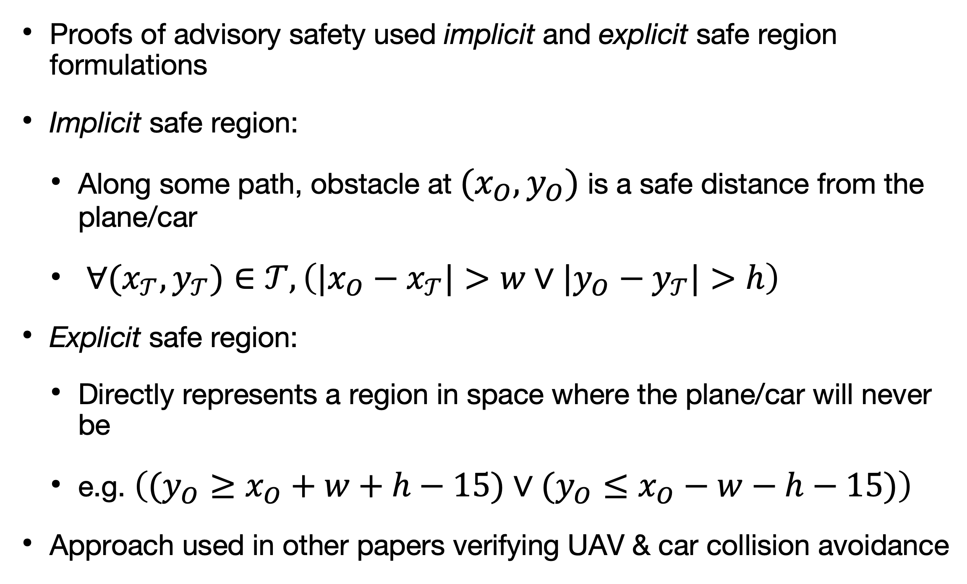
Inspiration
Past Approach
Proofs of advisory safety used implicit and explicit safe region formulations
Implicit safe region:
Along some path, obstacle at $(x_{O},y_{O})$ is a safe distance from the plane/car
$∀(x_{𝒯},y_{𝒯})∈𝒯,\left(|x_{O}−x_{𝒯}|>w∨|y_{O}−y_{𝒯}|>h\right)$
Explicit safe region:
Directly represents a region in space where the plane/car will never be
e.g. $\left((y_{O}≥x_{O}+w+h−15)∨(y_{O}≤x_{O}−w−h−15)\right)$
Approach used in other papers verifying UAV & car collision avoidance
Adler et al., AIAA ’19; Abhishek et al., HSCC ‘20

Slide 47
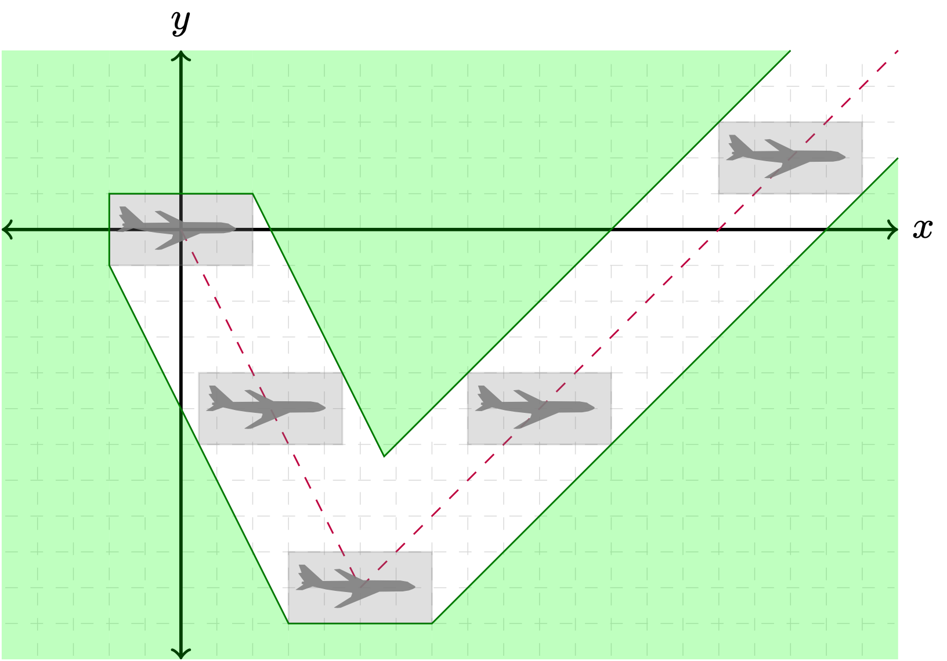
Algorithm
Automating Geometric Proofs of Collision Avoidance with Active Corners
Overview
Given a convex polygon translating on a known piecewise trajectory $𝒯$
$𝒯 =\left\{\begin{aligned}y=−2x, x∈[0, 5] \\ &y=x−15, x∈[5, ∞)\end{aligned}\right.$
$∀(x_{𝒯},y_{𝒯})∈𝒯,\left(|x_{O}−x_{𝒯}|>w∨|y_{O}−y_{𝒯}|>h\right)$
Automatically construct a quantifier-free, geometric representation of the unsafe region
$$((x_{O}≥−w)∧(y_{O}≤h)∧(y_{O}≥−2x_{O}−2w−h)∧(x_{O}≤5+w)$$
$$∧(y_{O}≤−2x_{O}+2w+h)∧(y_{O}≥−10−h))⋁$$
$$((x_{O}≥5−w)∧(y_{O}≥−10−h)∧(y_{O}≤x_{O}+w+h−15)∧(y_{O}≥x_{O}−w−h−15))$$
Notes:
TODO fix curly bracket math appearance

Slide 48
Algorithm
Automating Geometric Proofs of Collision Avoidance with Active Corners
Intuition: Active Corners
“Follow the corners”
We found that the safe region boundaries were either sides of the polygon or trajectories of its corners

Slide 49
Algorithm
Intuition: Active Corners
“Follow the corners”
We found that the safe region boundaries were either sides of the polygon or trajectories of its corners

Slide 50
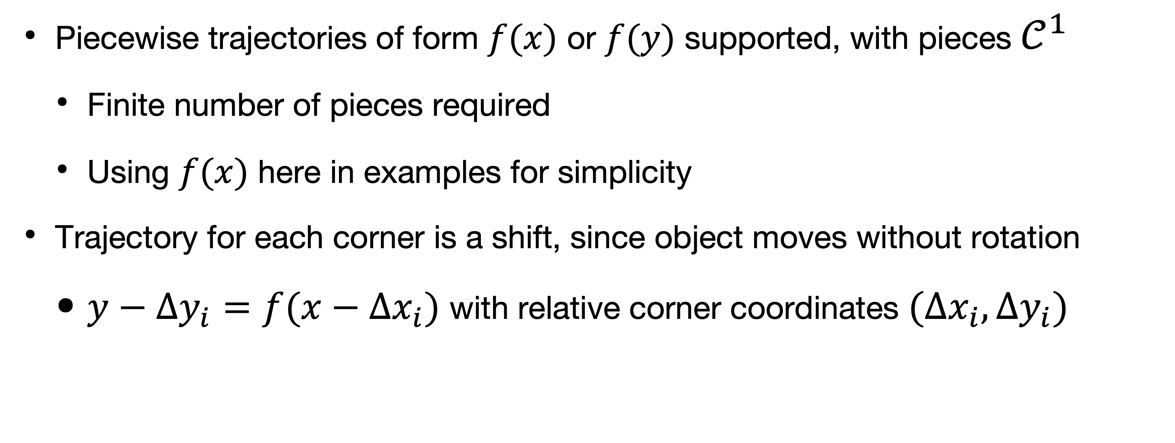
Algorithm
Technical Details
Piecewise trajectories of form $f(x)$ or $f(y)$ supported, with pieces $𝒞^{1}$
Finite number of pieces required
Using $f(x)$ here in examples for simplicity
Trajectory for each corner is a shift, since object moves without rotation
$y−Δy_{i}=f(x−Δx_{i})$ with relative corner coordinates $(Δx_{i},Δy_{i})$

Slide 51
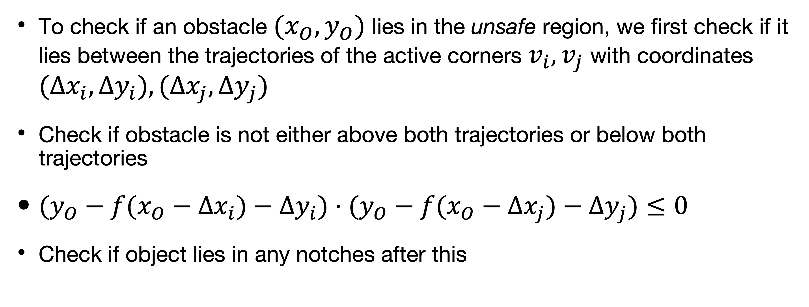
Algorithm
To check if an obstacle $(x_{O},y_{O})$ lies in the unsafe region, we first check if it lies between the trajectories of the active corners $v_{i},v_{j}$ with coordinates $(Δx_{i},Δy_{i}),(Δx_{j},Δy_{j})$
Check if obstacle is not either above both trajectories or below both trajectories
$(y_{O}−f(x_{O}−Δx_{i})−Δy_{i})⋅(y_{O}−f(x_{O}−Δx_{j})−Δy_{j})≤0$
Check if object lies in any notches after this

Slide 52
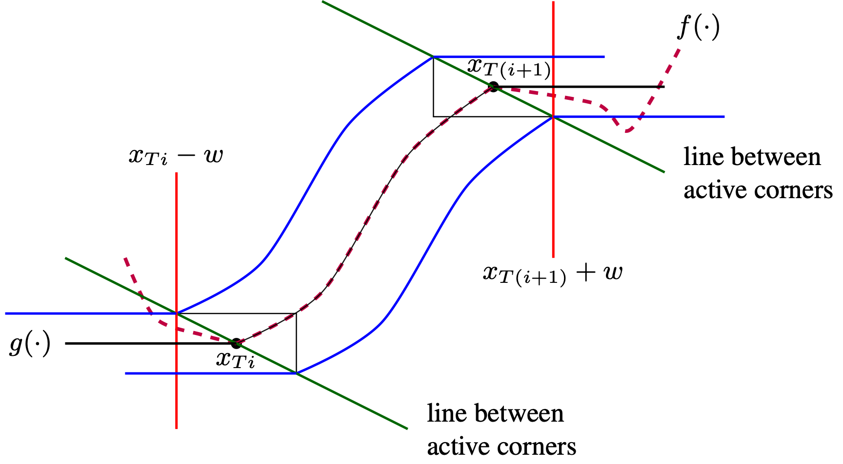
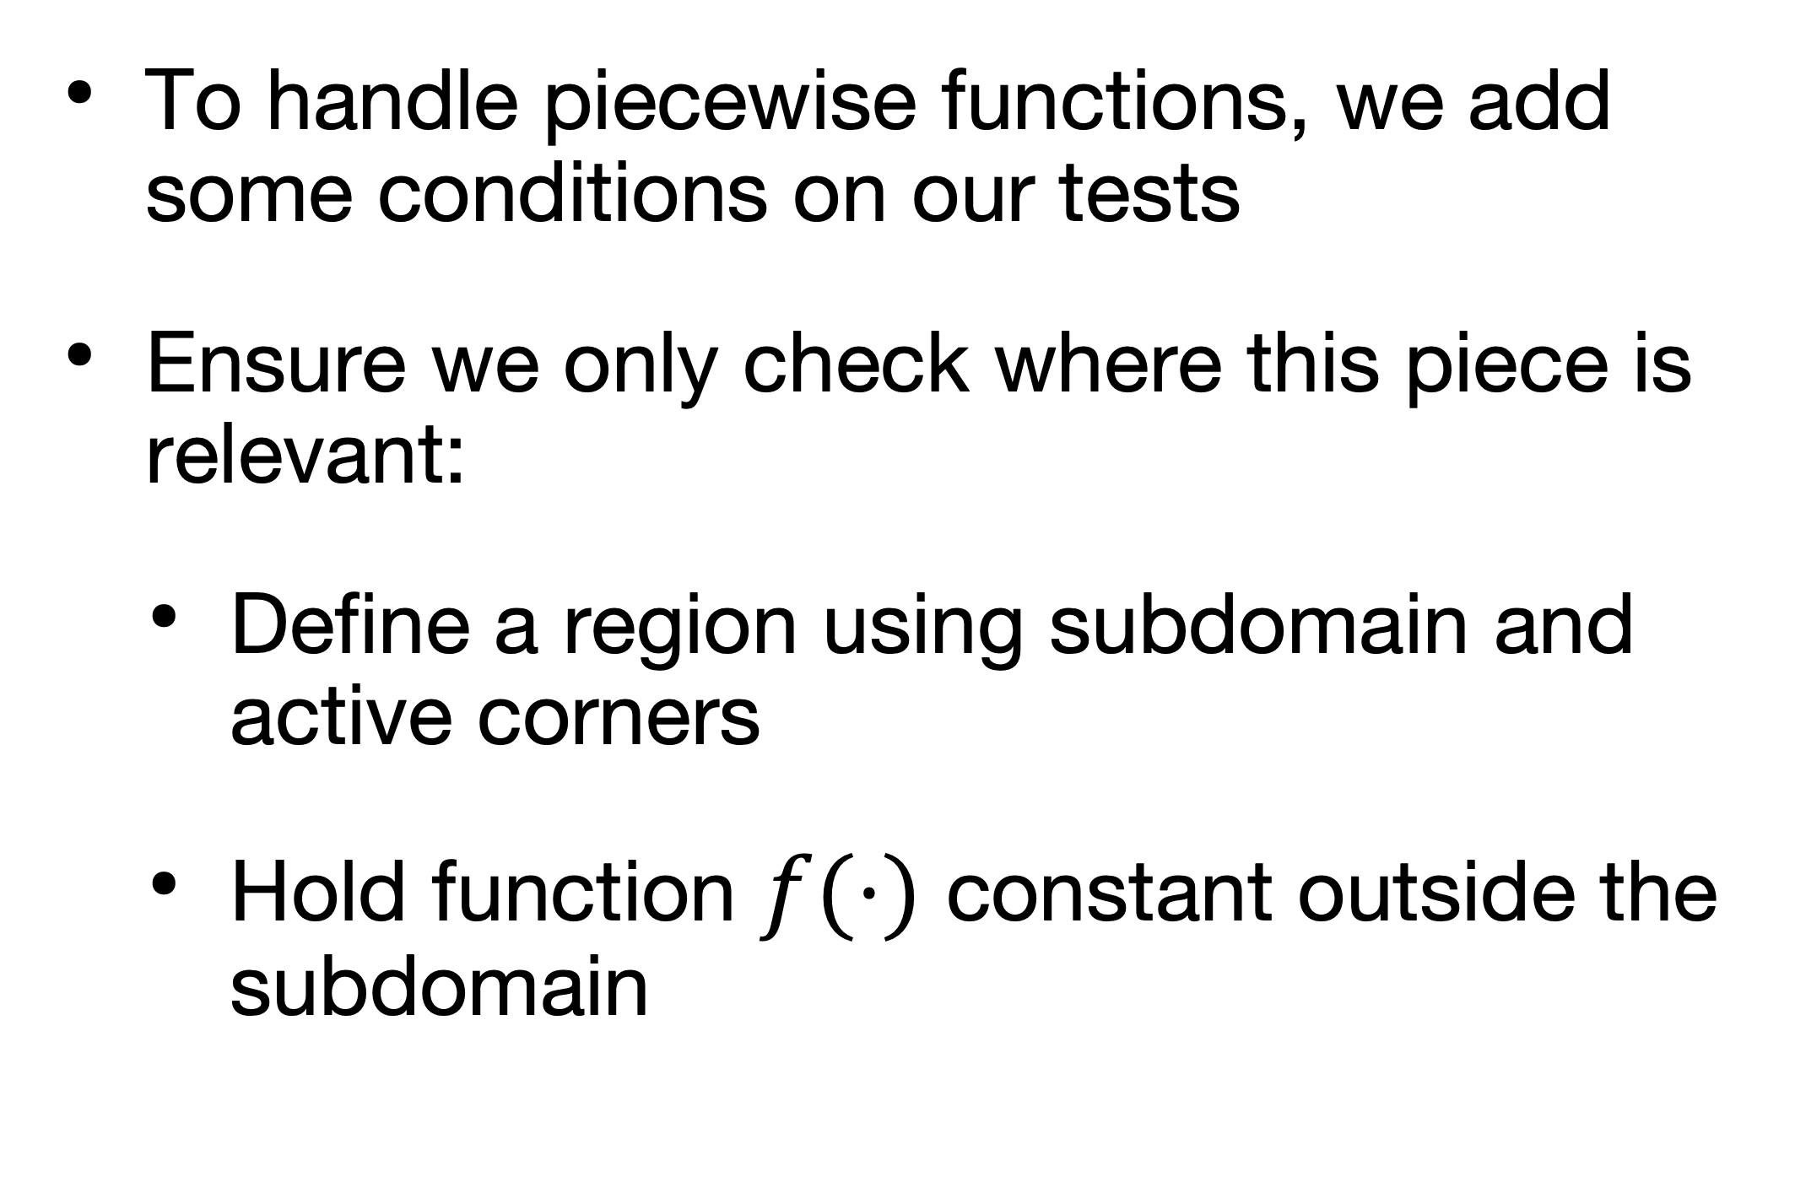
Algorithm
Piecewise handling
To handle piecewise functions, we add some conditions on our tests
Ensure we only check where this piece is relevant:
Define a region using subdomain and active corners
Hold function $f(⋅)$ constant outside the subdomain

Slide 53
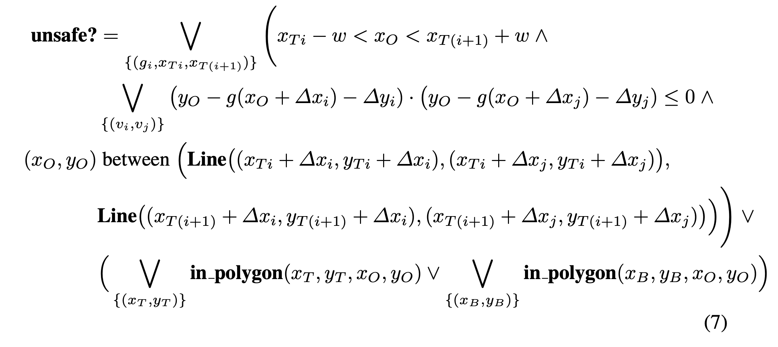
Algorithm
Full Test Rule
Intervals defined by transition points and piecewise bounds
Piecewise handling: region based on subdomain
Check if obstacle lies between
active corner trajectories
Piecewise handling: line
between active corners
All transition points
All piecewise bounds

Slide 54
Algorithm
Full Test Rule
Intervals defined by transition points and piecewise bounds
Piecewise handling: region based on subdomain
Check if obstacle lies between
active corner trajectories
Piecewise handling: line
between active corners
All transition points
All piecewise bounds

Slide 55
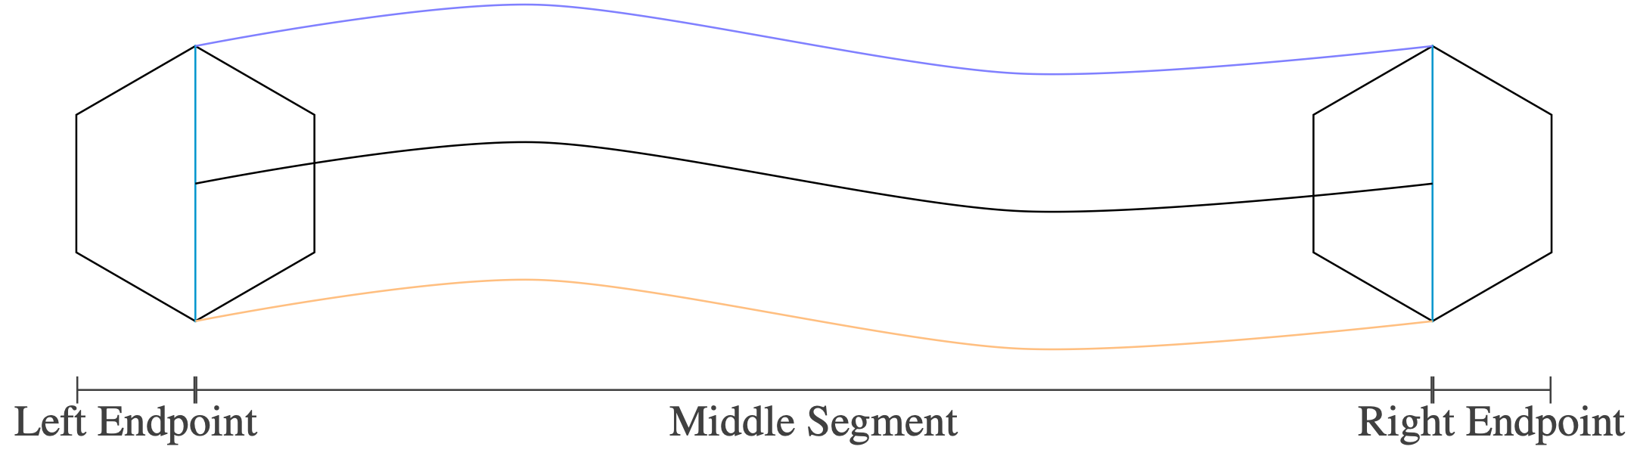
Proof Structure
Automating Geometric Proofs of Collision Avoidance with Active Corners
Proved equivalence of our method’s output to the input implicit region
Proof deals with (rotated) segments of trajectory over which there is no active corner change and includes start & end transition points
Accounts for notch handling this way
Notes:
Our method views this safe region computation problem as following corners with occasional polygons
but proof ensures our approach is correct but focusing directly on the transition points
- left and right endpoints are both transition points, two points at which we account for the notch by using the polygon itself
proof strategy considers this almost inside-out: focus on transition points & polygons there, and follow the corners in the between

Slide 56
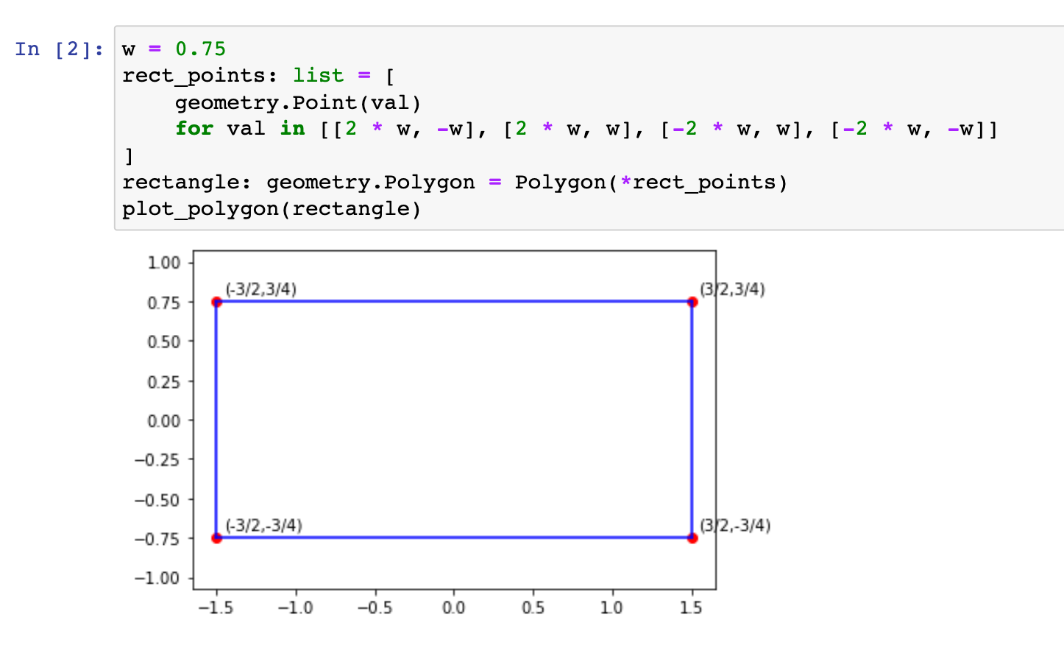
Applications
Case Study 1
Applied to two past papers from our group performing collision avoidance verification
TACAS ’15 ACAS X verification paper with side-view of aircraft collision avoidance advisories
Rectangular object
Parabolic-then-linear path
Jeannin et al., TACAS ‘15

Slide 57
Performance Evaluation
Automating Geometric Proofs of Collision Avoidance with Active Corners
Case Study 1
TACAS ’15 ACAS X verification paper with side-view of aircraft collision avoidance advisories
For this polynomial example, CAD performs comparably to our implementation for numeric cases
Our implementation begins to beat CAD as the problem becomes increasingly symbolic

Slide 58
Performance Evaluation
Automating Geometric Proofs of Collision Avoidance with Active Corners
Case Study 1
TACAS ’15 ACAS X verification paper with side-view of aircraft collision avoidance advisories
As for memory usage, CAD uses less memory than our implementation
Note that Mathematica is purpose-built for efficient mathematical computation
Notes:
TODO add units

Slide 59
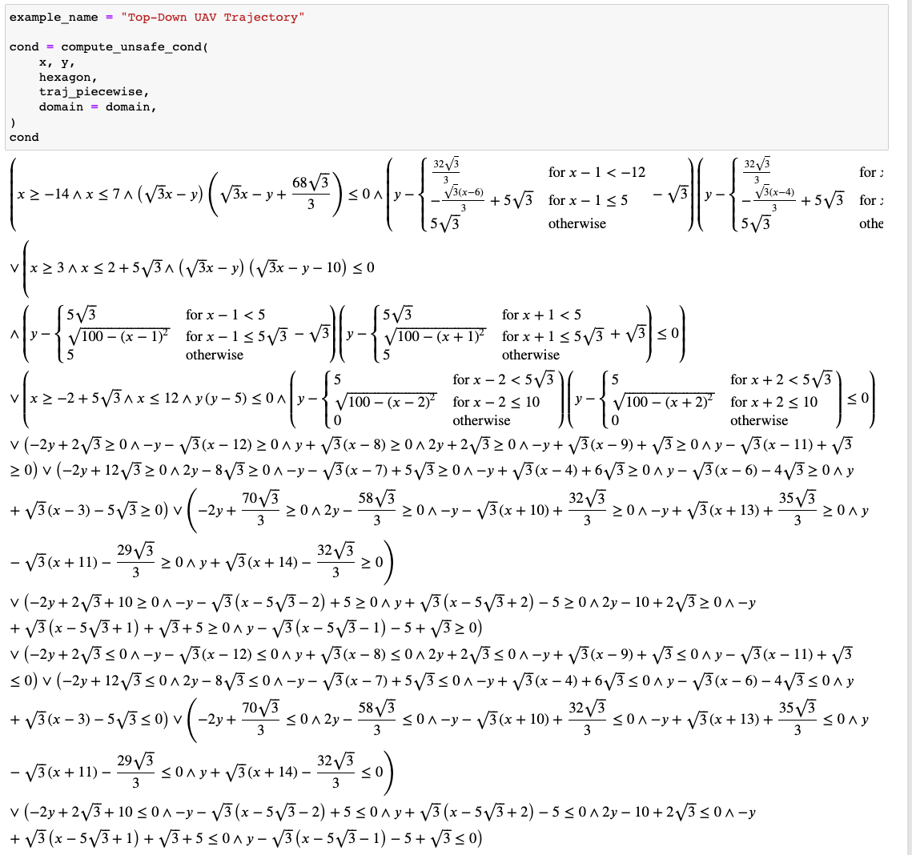
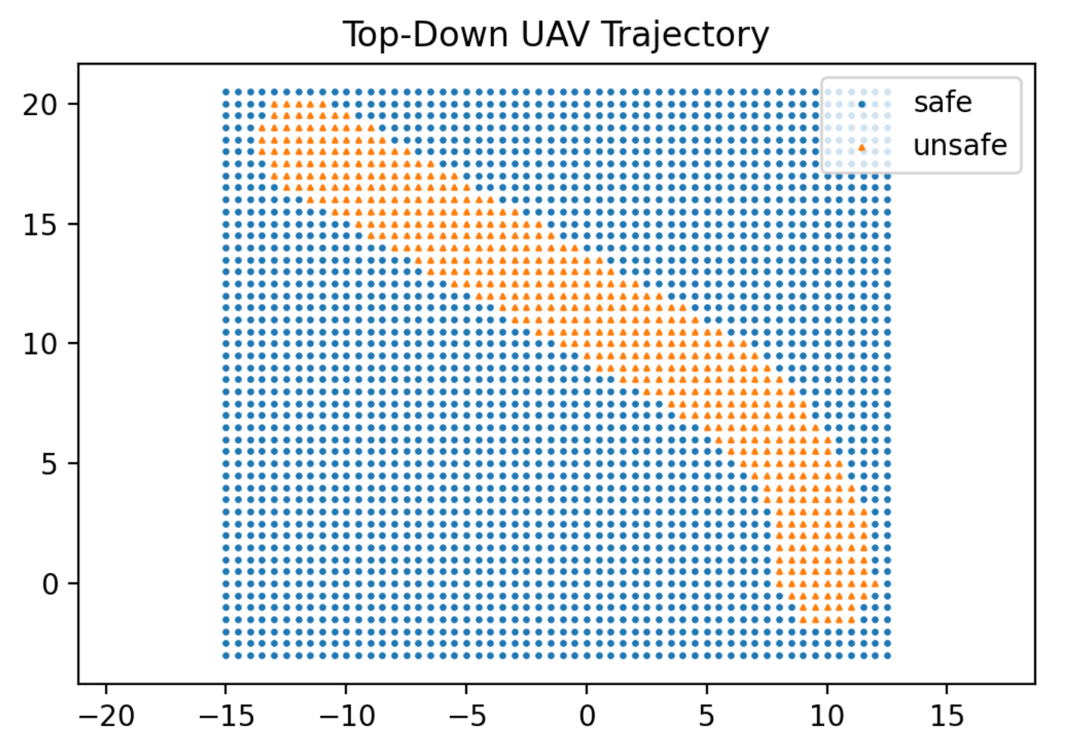
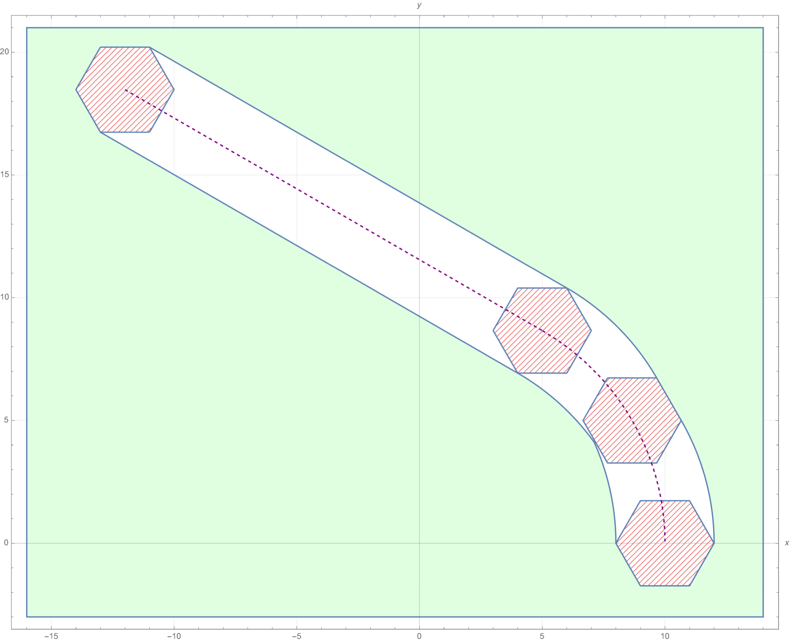
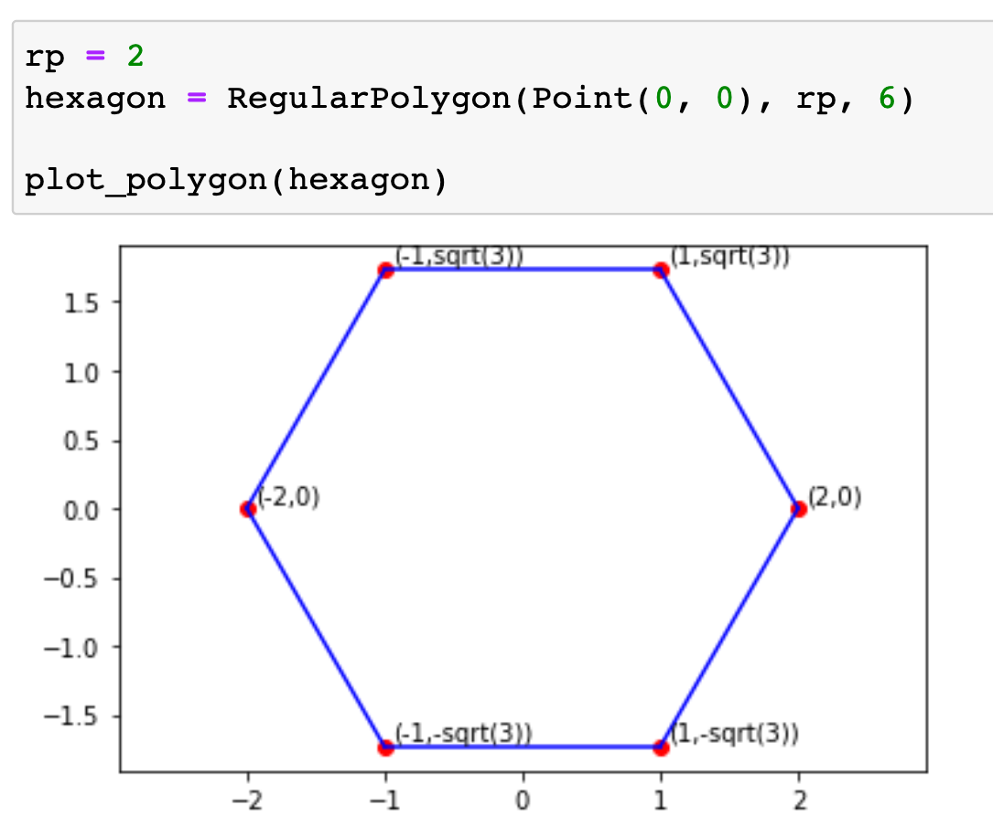
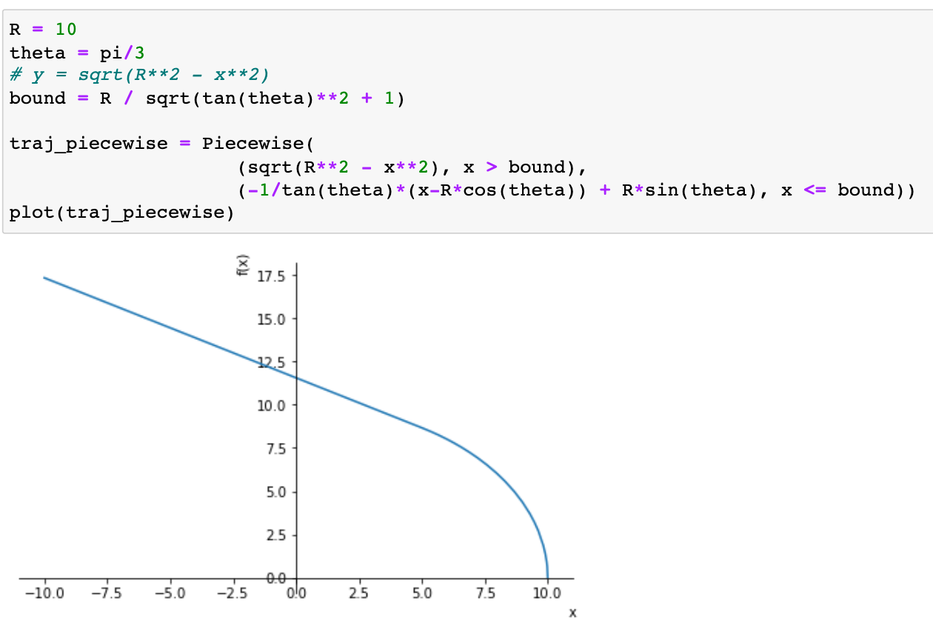
Applications
Case Study 2
Applied to two past papers from our group performing collision avoidance verification
UAV top-down collision avoidance
Overapproximate circular object in a hexagon
Circular-then-linear path
Adler et al., AIAA ‘19

Slide 60
Performance Evaluation
Automating Geometric Proofs of Collision Avoidance with Active Corners
Case Study 2
UAV top-down collision avoidance
CAD does not terminate for all but the fully numeric example
Our implementation runs in under a minute at worst

Slide 61
Performance Evaluation
Automating Geometric Proofs of Collision Avoidance with Active Corners
Case Study 2
UAV top-down collision avoidance
For all but the fully numeric case, CAD memory usage explodes to over 50 GB
Our implementation keeps memory usage under 25 MB

